Slide 1
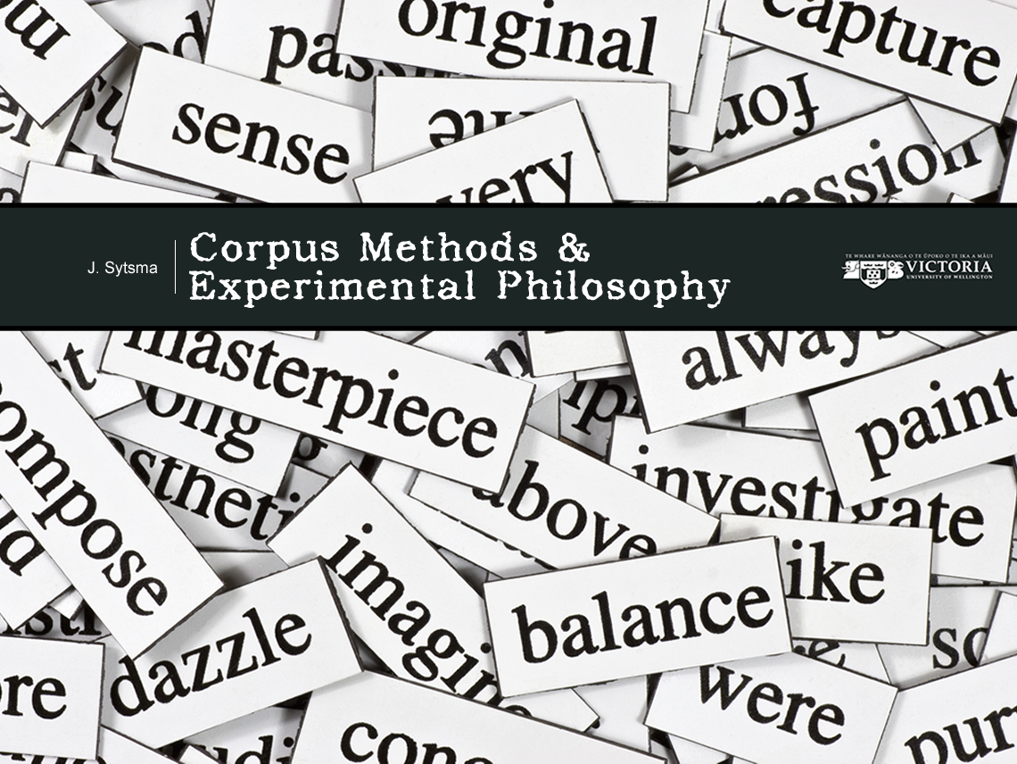

Slide 2

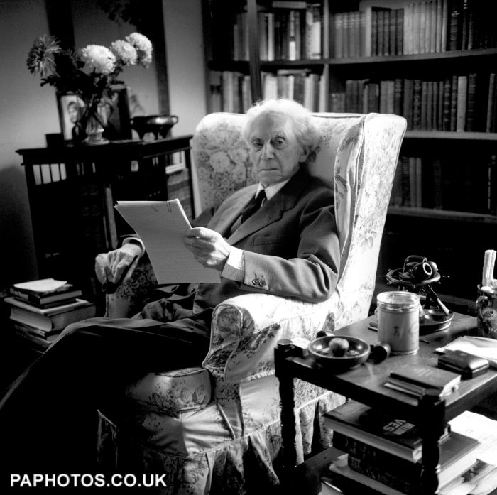

Slide 3
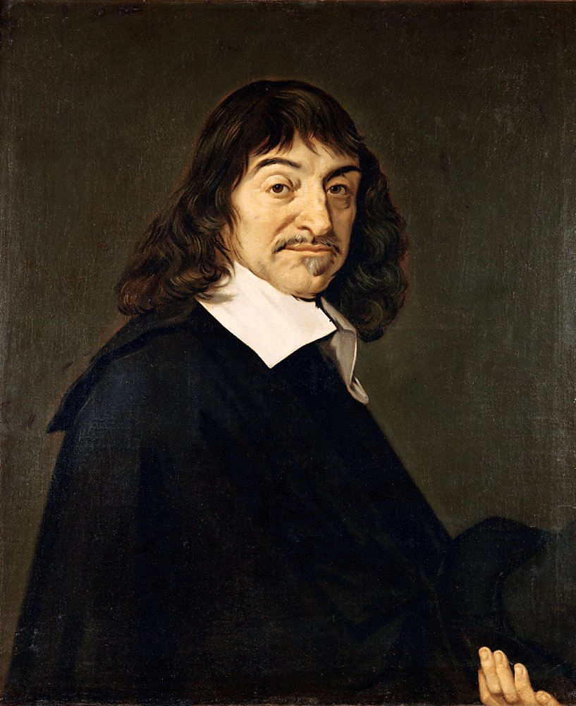
Several years have now passed since I first realized how numerous were the false opinions that in my youth I had taken to be true, and thus how doubtful were all those that I had subsequently built upon them. And thus I realized that once in my life I had to raze everything to the ground and begin again from the original foundations, if I wanted to establish anything firm and lasting in the sciences…. Accordingly, I have today suitably freed my mind of all cares, secured for myself a period of leisurely tranquility, and am withdrawing into solitude.
At last I will apply myself earnestly and unreservedly to this general demolition of my opinions. (First Meditation)

Slide 4


Slide 5
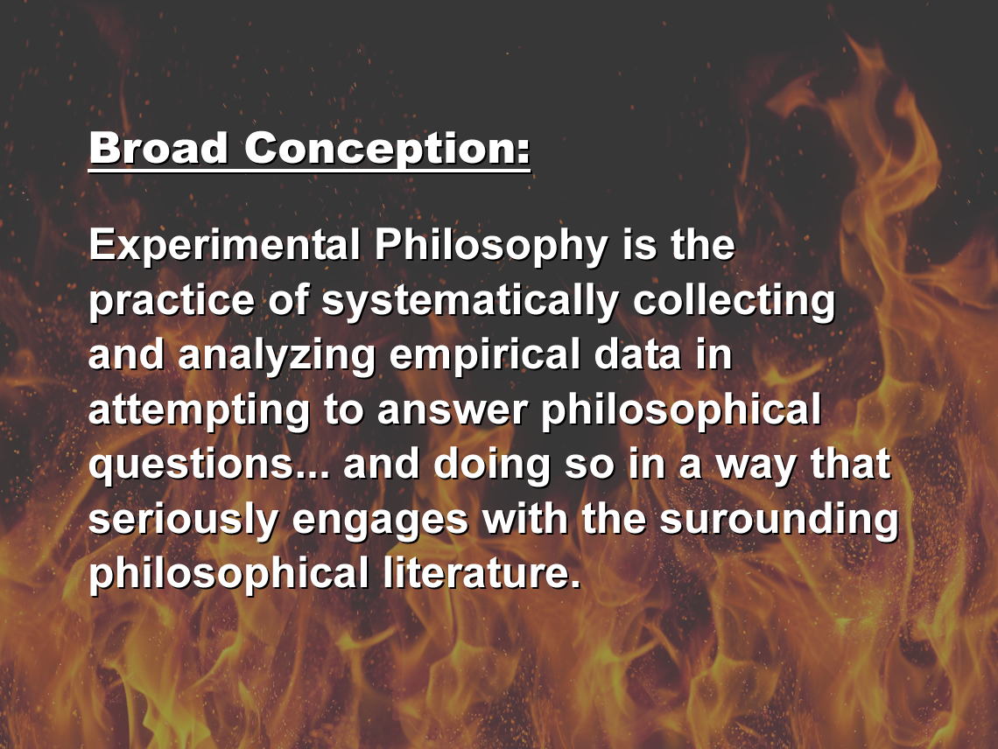

Slide 6
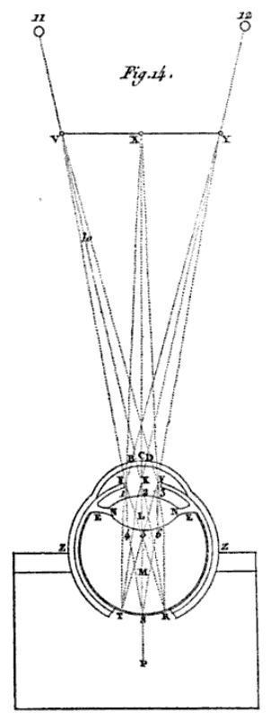
Thus you can clearly see that in order to perceive, the mind need not contemplate any images resembling the things that it senses. But this makes it no less true that the objects we look at do imprint very perfect images on the back of our eyes.... You will be even more certain of this if, taking the eye of a newly deceased man, or, for want of that, of an ox or some other large animal, you carefully cut through to the back the three membranes which enclose it, in such a manner that a large part of the humor M [see Figure 0.1] which is there remains exposed without any of it spilling out because of this. Then, having covered it over with some white body thin enough to let the daylight pass through it, as for example with a piece of paper or with an eggshell, RST, place this eye in the hole of a specially made window such as Z, in such a manner so that it has its front, BCD, turned toward some location where there are various objects, such as V, X, Y, illuminated by the sun; and the back of it, where the white body RST is located, toward the inside of the chamber P (where you will be), into which no other light is allowed to enter except that which will be able to penetrate through this eye, all of whose parts, from C to S, you know to be transparent. For when this has been done, if you look at that white body RST, you will see there, not perhaps without admiration and pleasure, a picture which will represent in natural perspective all the objects which will be outside of it toward VXY…. But I must explain here at greater length how this picture is formed; for, by the same means, I can enable you to understand several things which pertain to vision. (Optics, Fifth Discourse)

Slide 7


Slide 8
Have employed many methods…
But the dominant tool has been
questionnaire methods.
Often give participants a vignette (story),
and ask a question involving the application
of a term of interest (“concept”).
For example, whether the concept of
intentionality applies to a given action…

Slide 9

“What is it to do something intentionally?
“Philosophical work on this question is motivated by a
variety of interrelated concerns. In trying to understand
and explain human action, a project that is as old as Plato
and Aristotle, philosophers of action are concerned
primarily with intentional actions. In discussions of
freedom of action, intentional action also naturally
occupies center stage. And although people are morally
accountable for some unintentional actions, as in cases
of negligence, moral assessment of actions is focused
primarily upon intentional actions.”
Al Mele (2001),
“Acting Intentionally:
Probing Folk Notions,”
Page 27

Slide 10
“In my opinion, any adequate answer… will be anchored by
common-sense judgments about particular hypothetical
or actual actions. One can test attempted philosophical
analyses of intentional action partly by ascertaining whether
what these analyses entail about particular actions is in line
with what the majority of non-specialists would say….
“It is also worth noting that if there is a widely shared
concept of intentional action, such judgments provide
evidence about what that concept is, and a philosophical
analysis of intentional action that is wholly unconstrained
by that concept runs the risk of having nothing more
than a philosophical fiction as its subject matter.”
Al Mele (2001),
“Acting Intentionally:
Probing Folk Notions,”
Page 27

Slide 11
One question (among many): Does the
ordinary concept of intentionality allow
that a side effect could be brought about
intentionally?
Philosophers have given different answers,
generally calling on their own sense of the
concept or what is meant by the term.
A classic piece of experimental philosophy
complicated the answer…

Slide 12
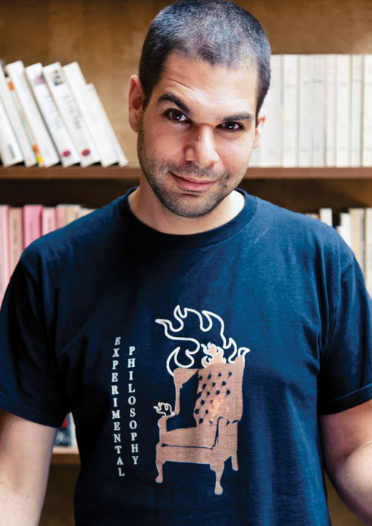
Knobe (2003),
“Intentional Action and
Side Effects in Ordinary
language,” Analysis,
63(3): 190-4
78 Participants
Manhattan Park
One of two conditions

Slide 13
Harm Condition
The vice-president of a company went to the chairman of
the board and said, “We are thinking of starting a new
program. It will help us increase profits, but it will also
harm the environment.”
The chairman of the board answered, “I don’t care at all
about harming the environment. I just want to make as
much profit as I can. Let’s start the new program.”
They started the new program. Sure enough, the
environment was harmed.
(1) How much blame does the chairman deserves (0 to 6)
(2) Did he intentionally harm the environment?
82% = Intentionally Harmed

Slide 14
Help Condition
The vice-president of a company went to the chairman of
the board and said, “We are thinking of starting a new
program. It will help us increase profits, but it will also
help the environment.”
The chairman of the board answered, “I don’t care at all
about helping the environment. I just want to make as
much profit as I can. Let’s start the new program.”
They started the new program. Sure enough, the
environment was helped.
(1) How much praise does the chairman deserves (0 to 6)
(2) Did he intentionally help the environment?
23% = Intentionally Helped

Slide 15

82% vs 23%!
General type of worry: Maybe such
results are driven by something about
the experimental context.
Perhaps the vignette
suggests to p’s that
they’re expected to
answer in this way,
or…

Slide 16

Especially when we’re investigating the
ordinary use of terms (“conceptual analysis”),
relevant to also get information about the
use of these terms in the wild, outside of
the experimental context.
Address worries
Consilience of evidence
General methodological advice
is to bring multiple channels
of evidence to bear on a
question of interest.

Slide 17
Corpus Analysis is especially well-suited
to investigating the ordinary meaning of terms.
Corpus = collection of texts
Analysis = looking at linguistic data in a corpus
and assessing it for a research purpose
Lots of corpora available (and you can
build your own)…
And a lot of things that can be done
with them…

Slide 18
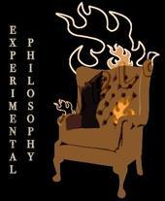



Slide 19
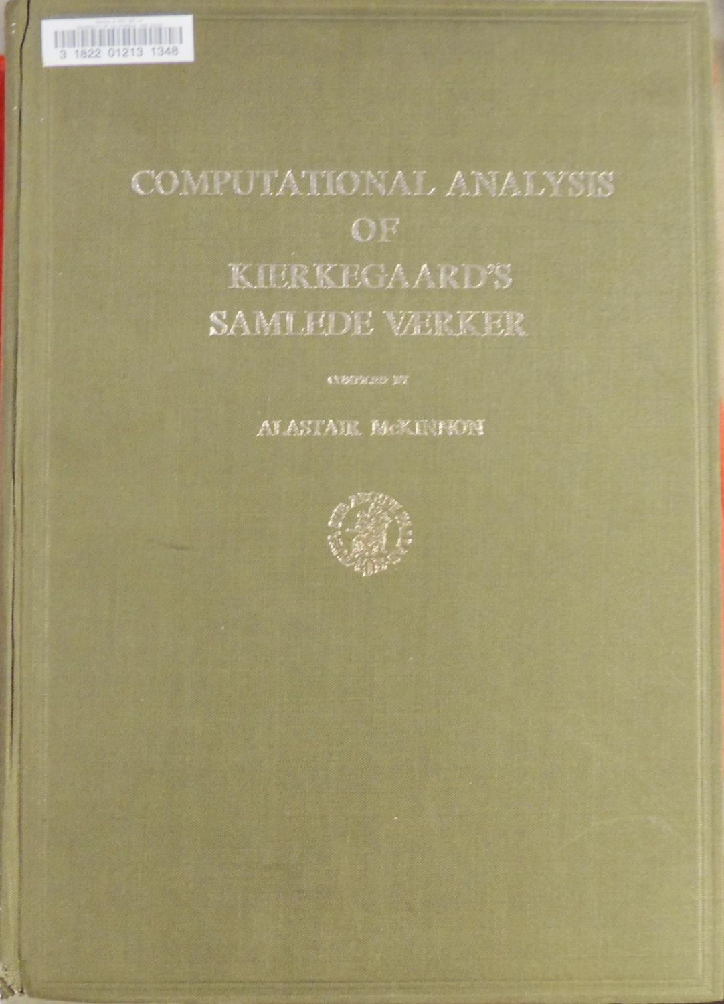
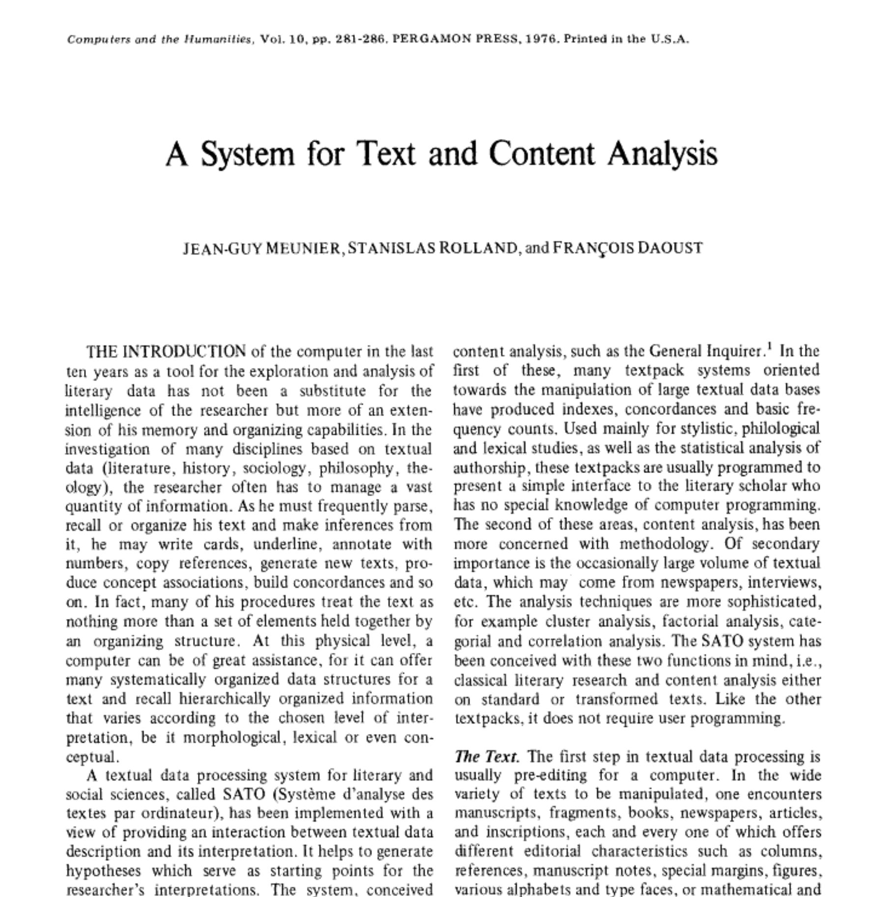

A decent amount of work has been done
in philosophy discussing or using
corpus methods: corpus_refs.pdf
In fact, a reasonably long history…

Slide 20
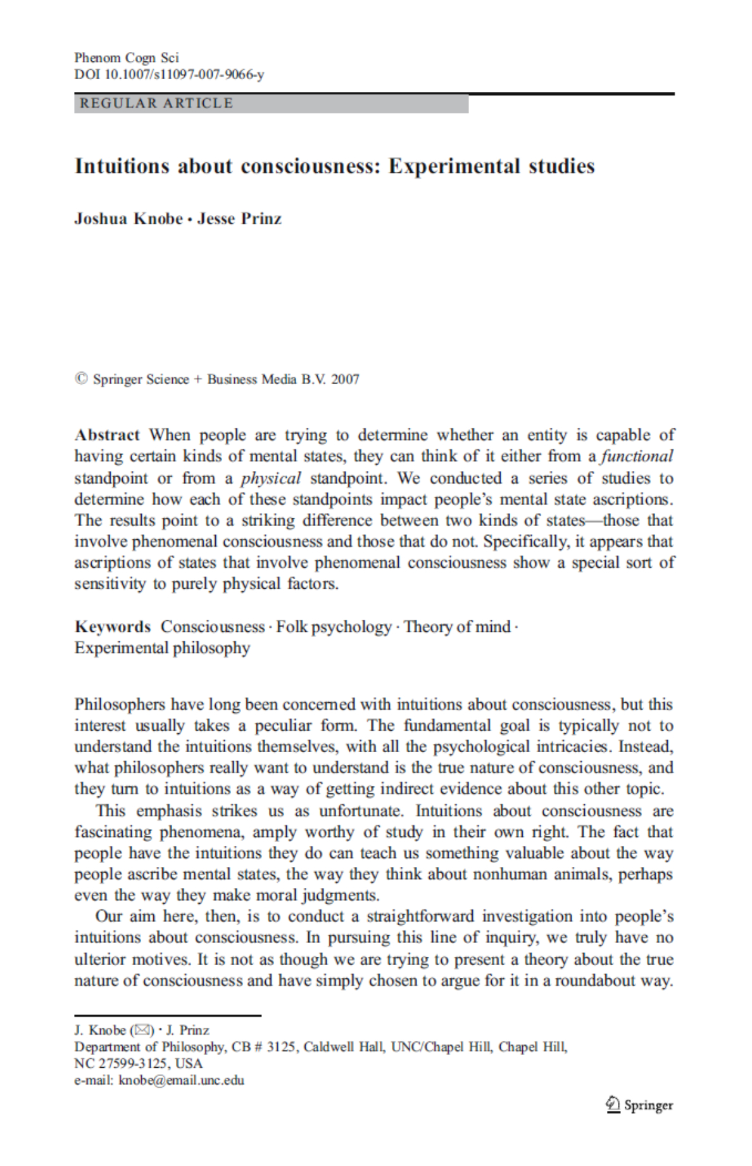
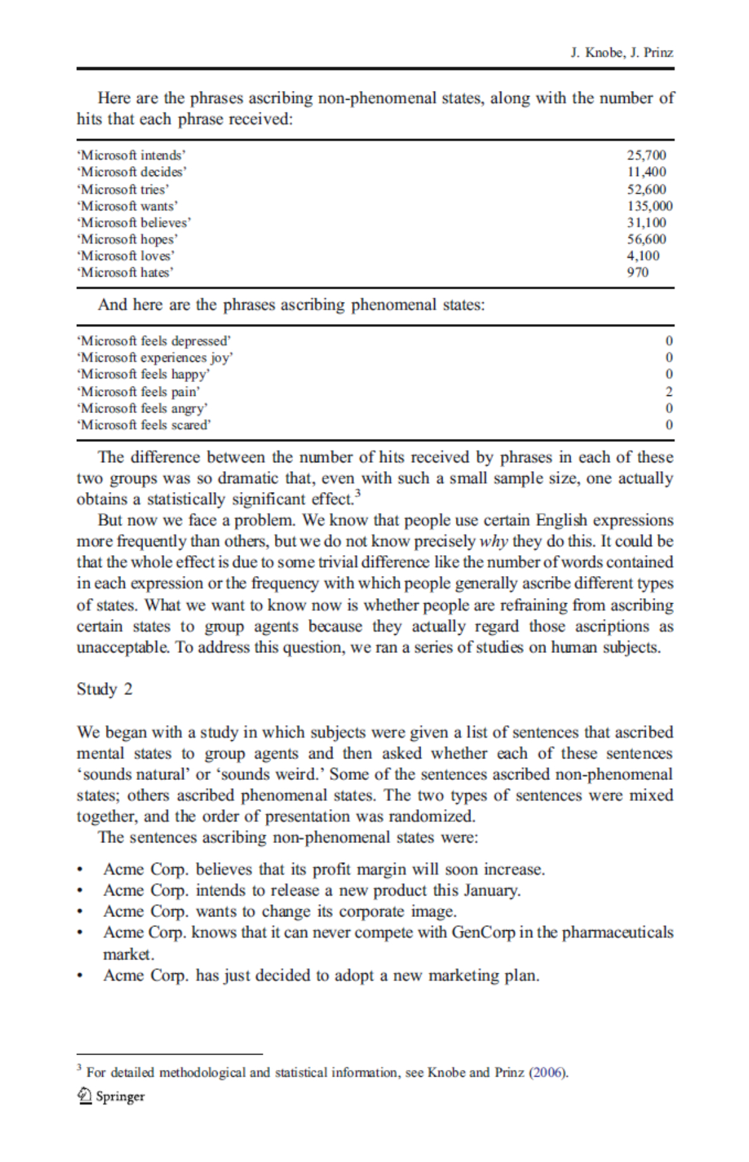
Includes use of the Web as a corpus (WaC).

Slide 21
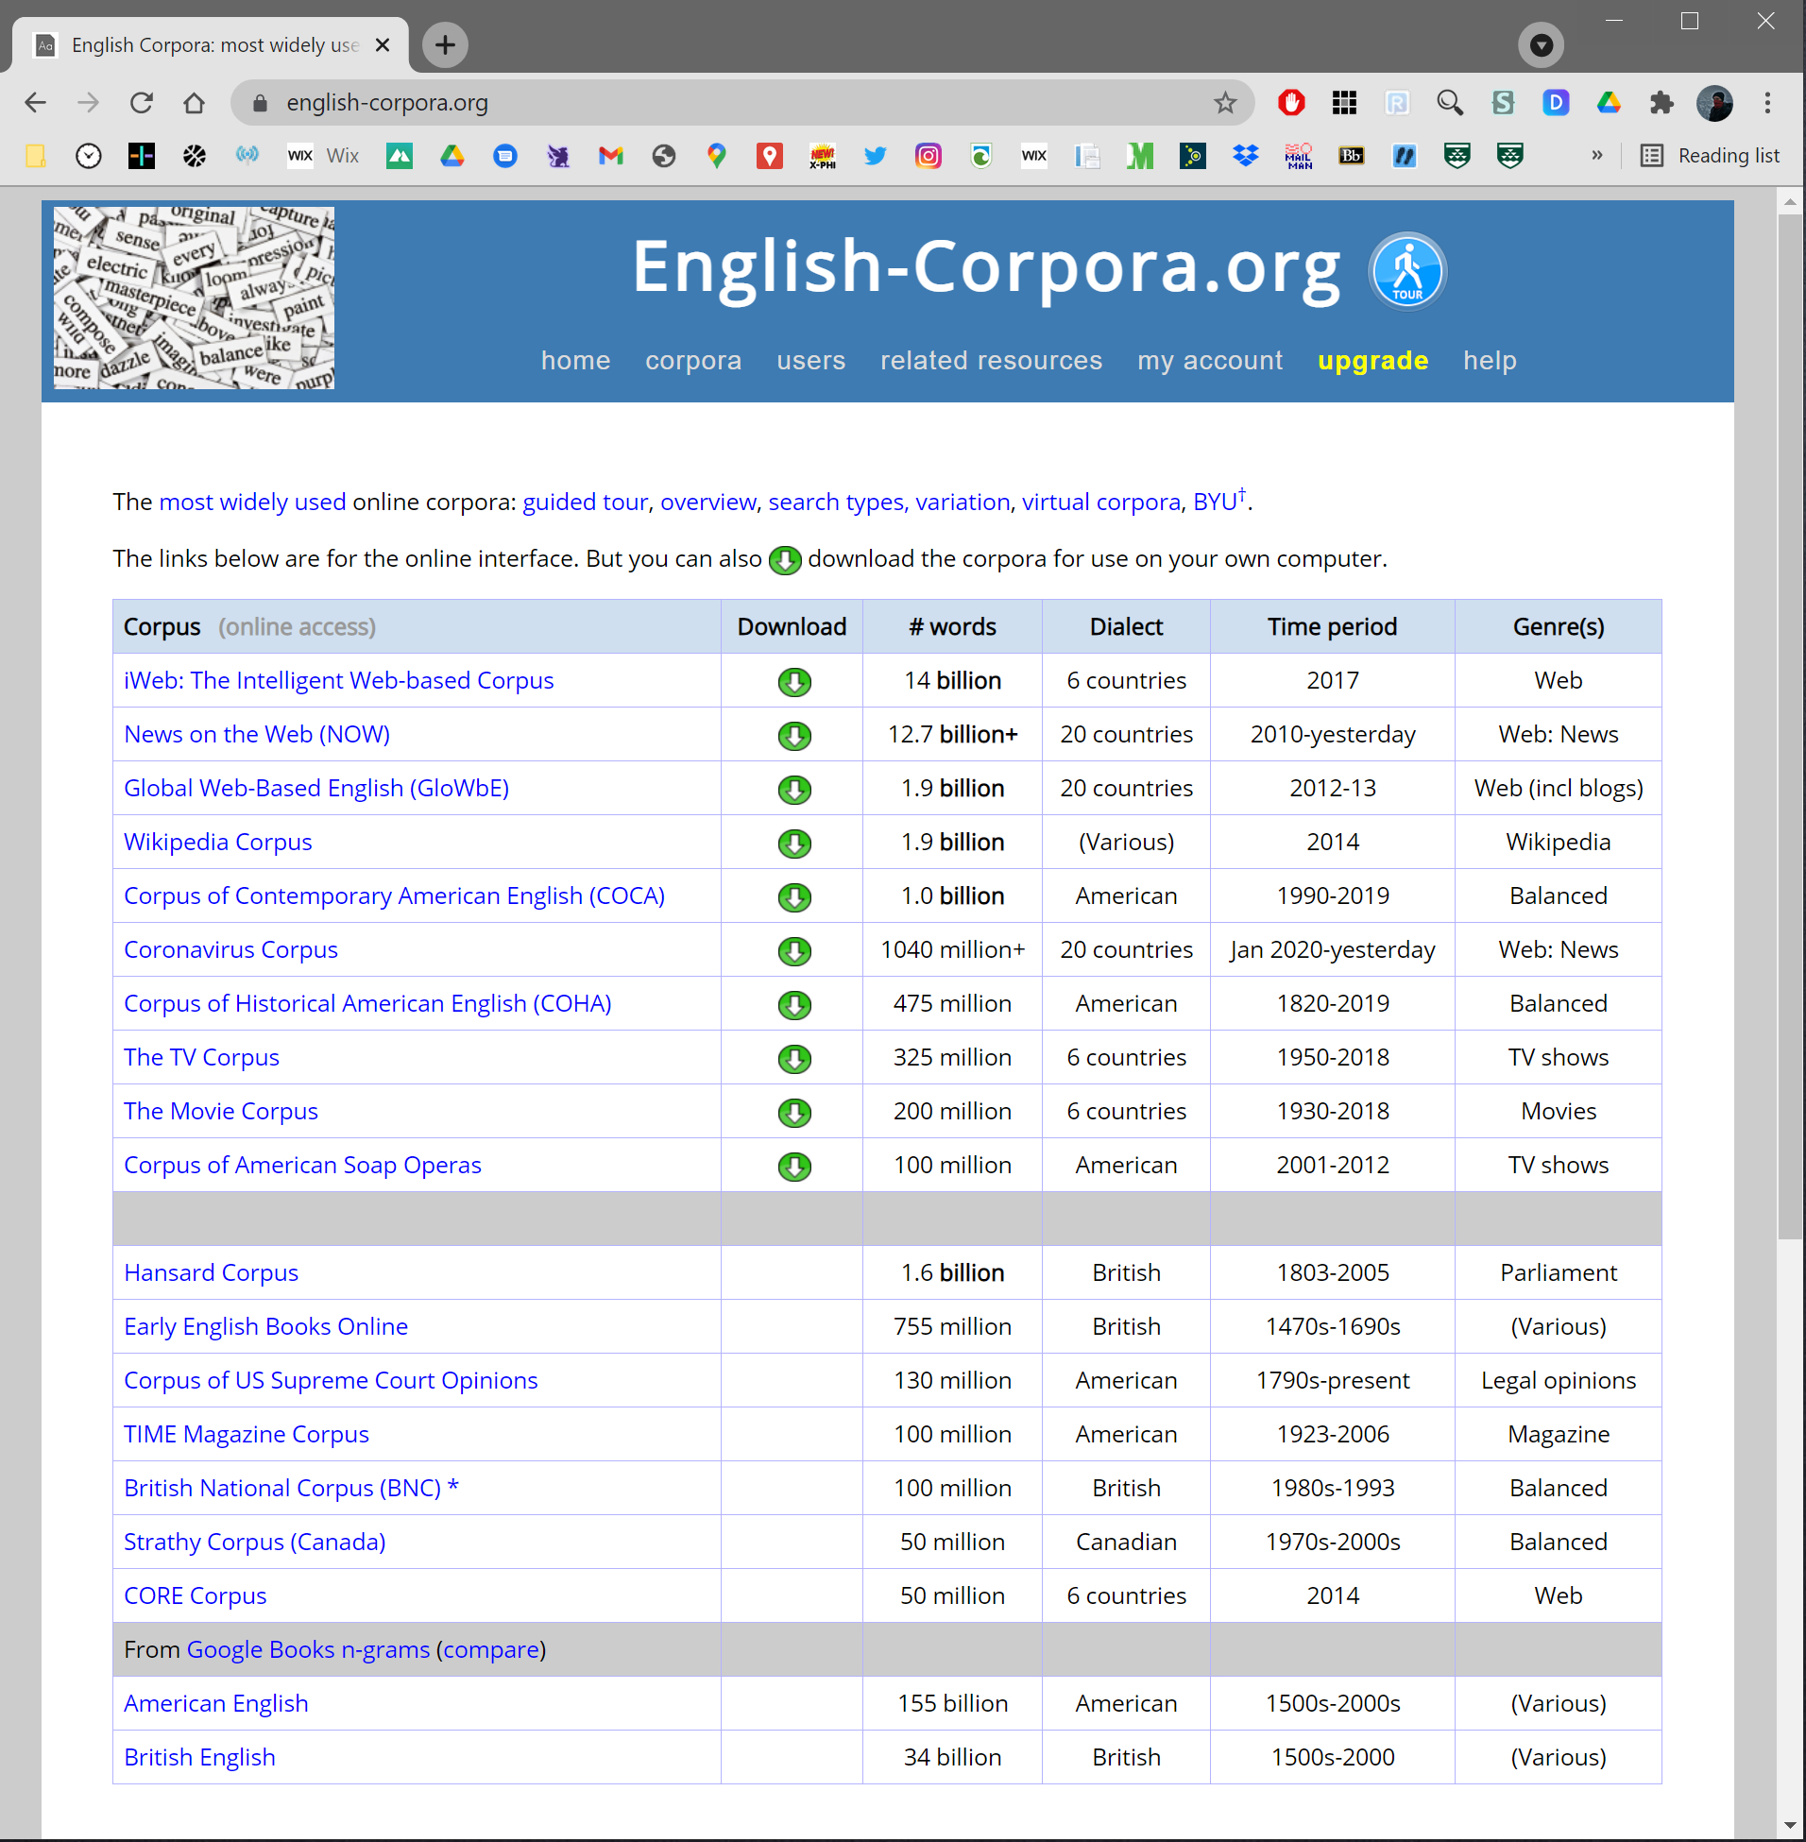
And the Web for building a corpus (WfC),
as well as accessing them.

Slide 22
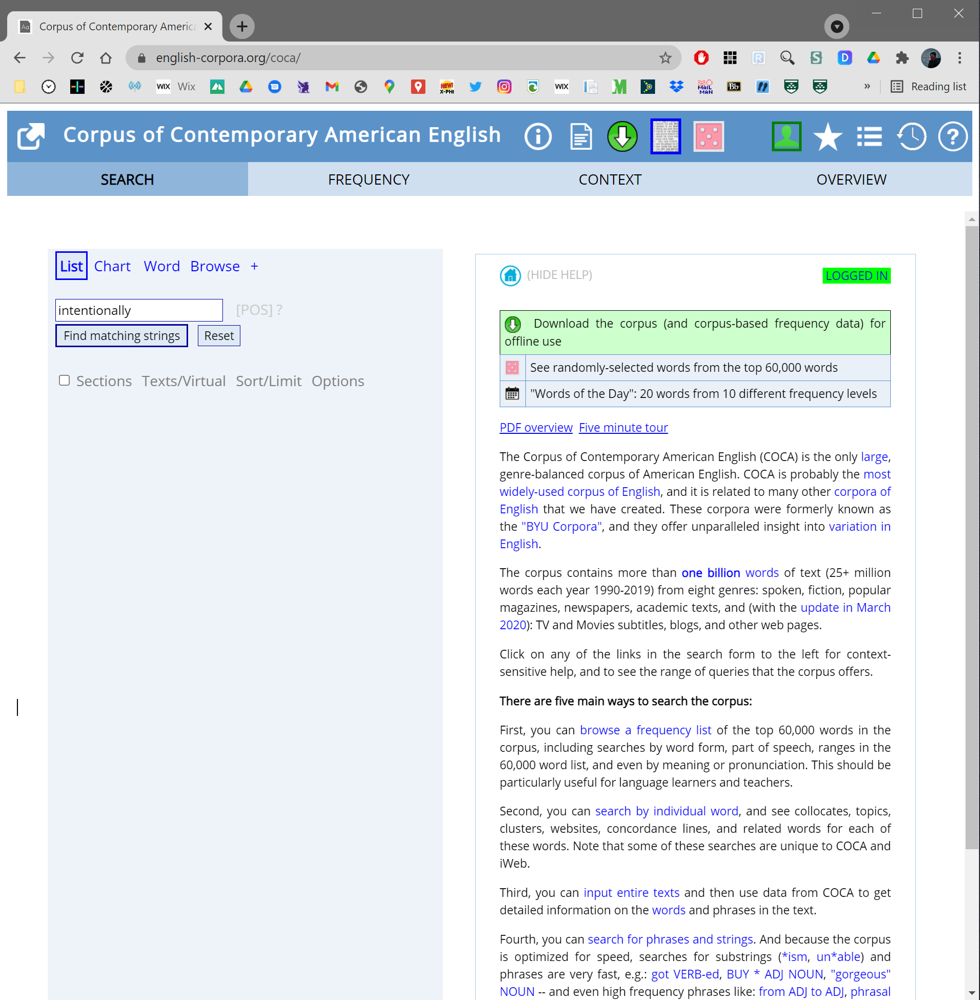

Slide 23
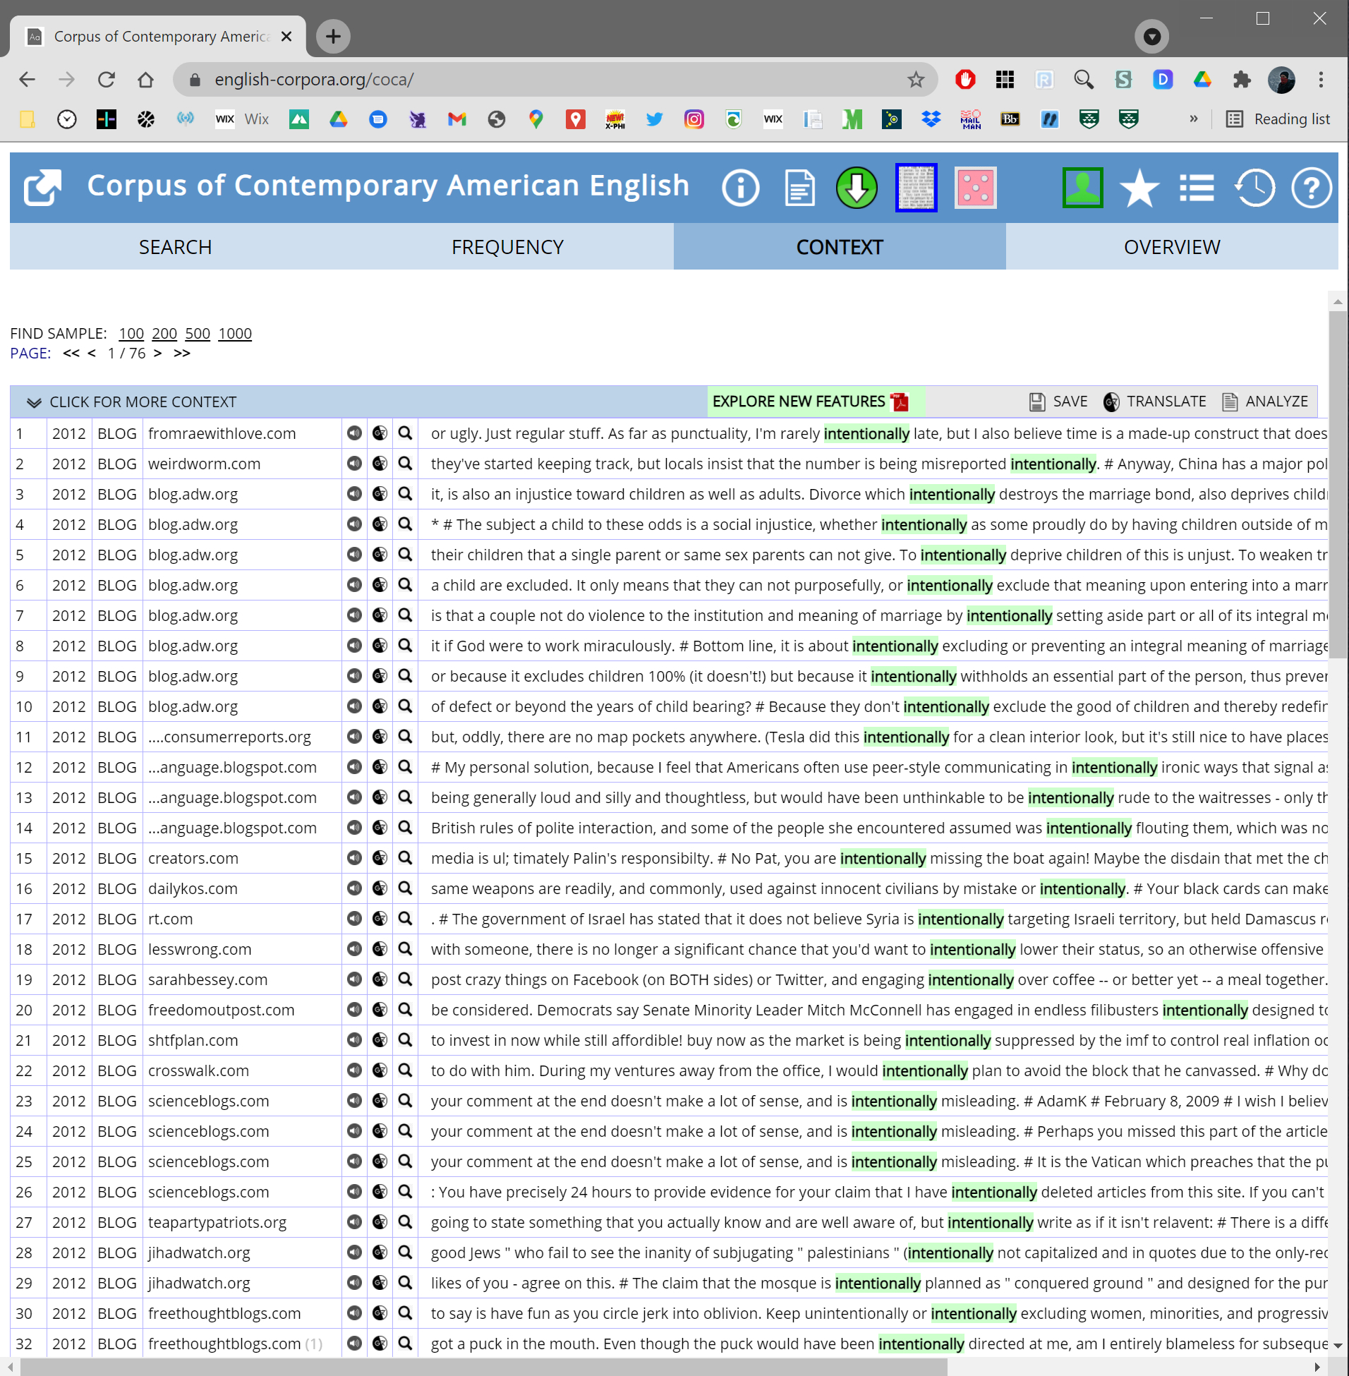

Slide 24
Can also (purchase and) download
COCA to do various things with it.
Distributional Semantic Model (DSM)
using word2vec on non-academic COCA…
Nearest neighbors to “intentionally”:
'deliberately’ 0.8082486391067505
'purposely’ 0.7684776186943054
'willfully’ 0.7106383442878723
'maliciously’ 0.6992570161819458
'inadvertently’ 0.6933962106704712
'unfairly’ 0.615240216255188

Slide 25
Can also (purchase and) download
COCA to do various things with it.
Distributional Semantic Model (DSM)
using word2vec on non-academic COCA…
Nearest neighbors to “intentionally”:
'deliberately’ 0.8082486391067505
'purposely’ 0.7684776186943054
'willfully’ 0.7106383442878723
'maliciously’ 0.6992570161819458
'inadvertently’ 0.6933962106704712
'unfairly’ 0.615240216255188

Slide 26
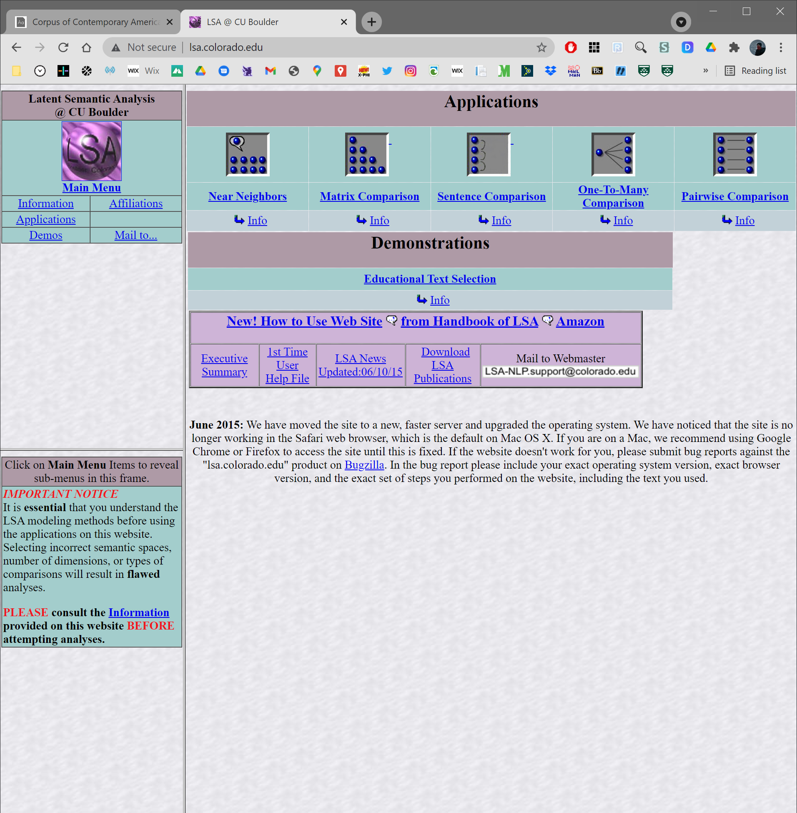
Will look more at COCA and DSM
in later sessions…
including DSM tools available on the web

Slide 27
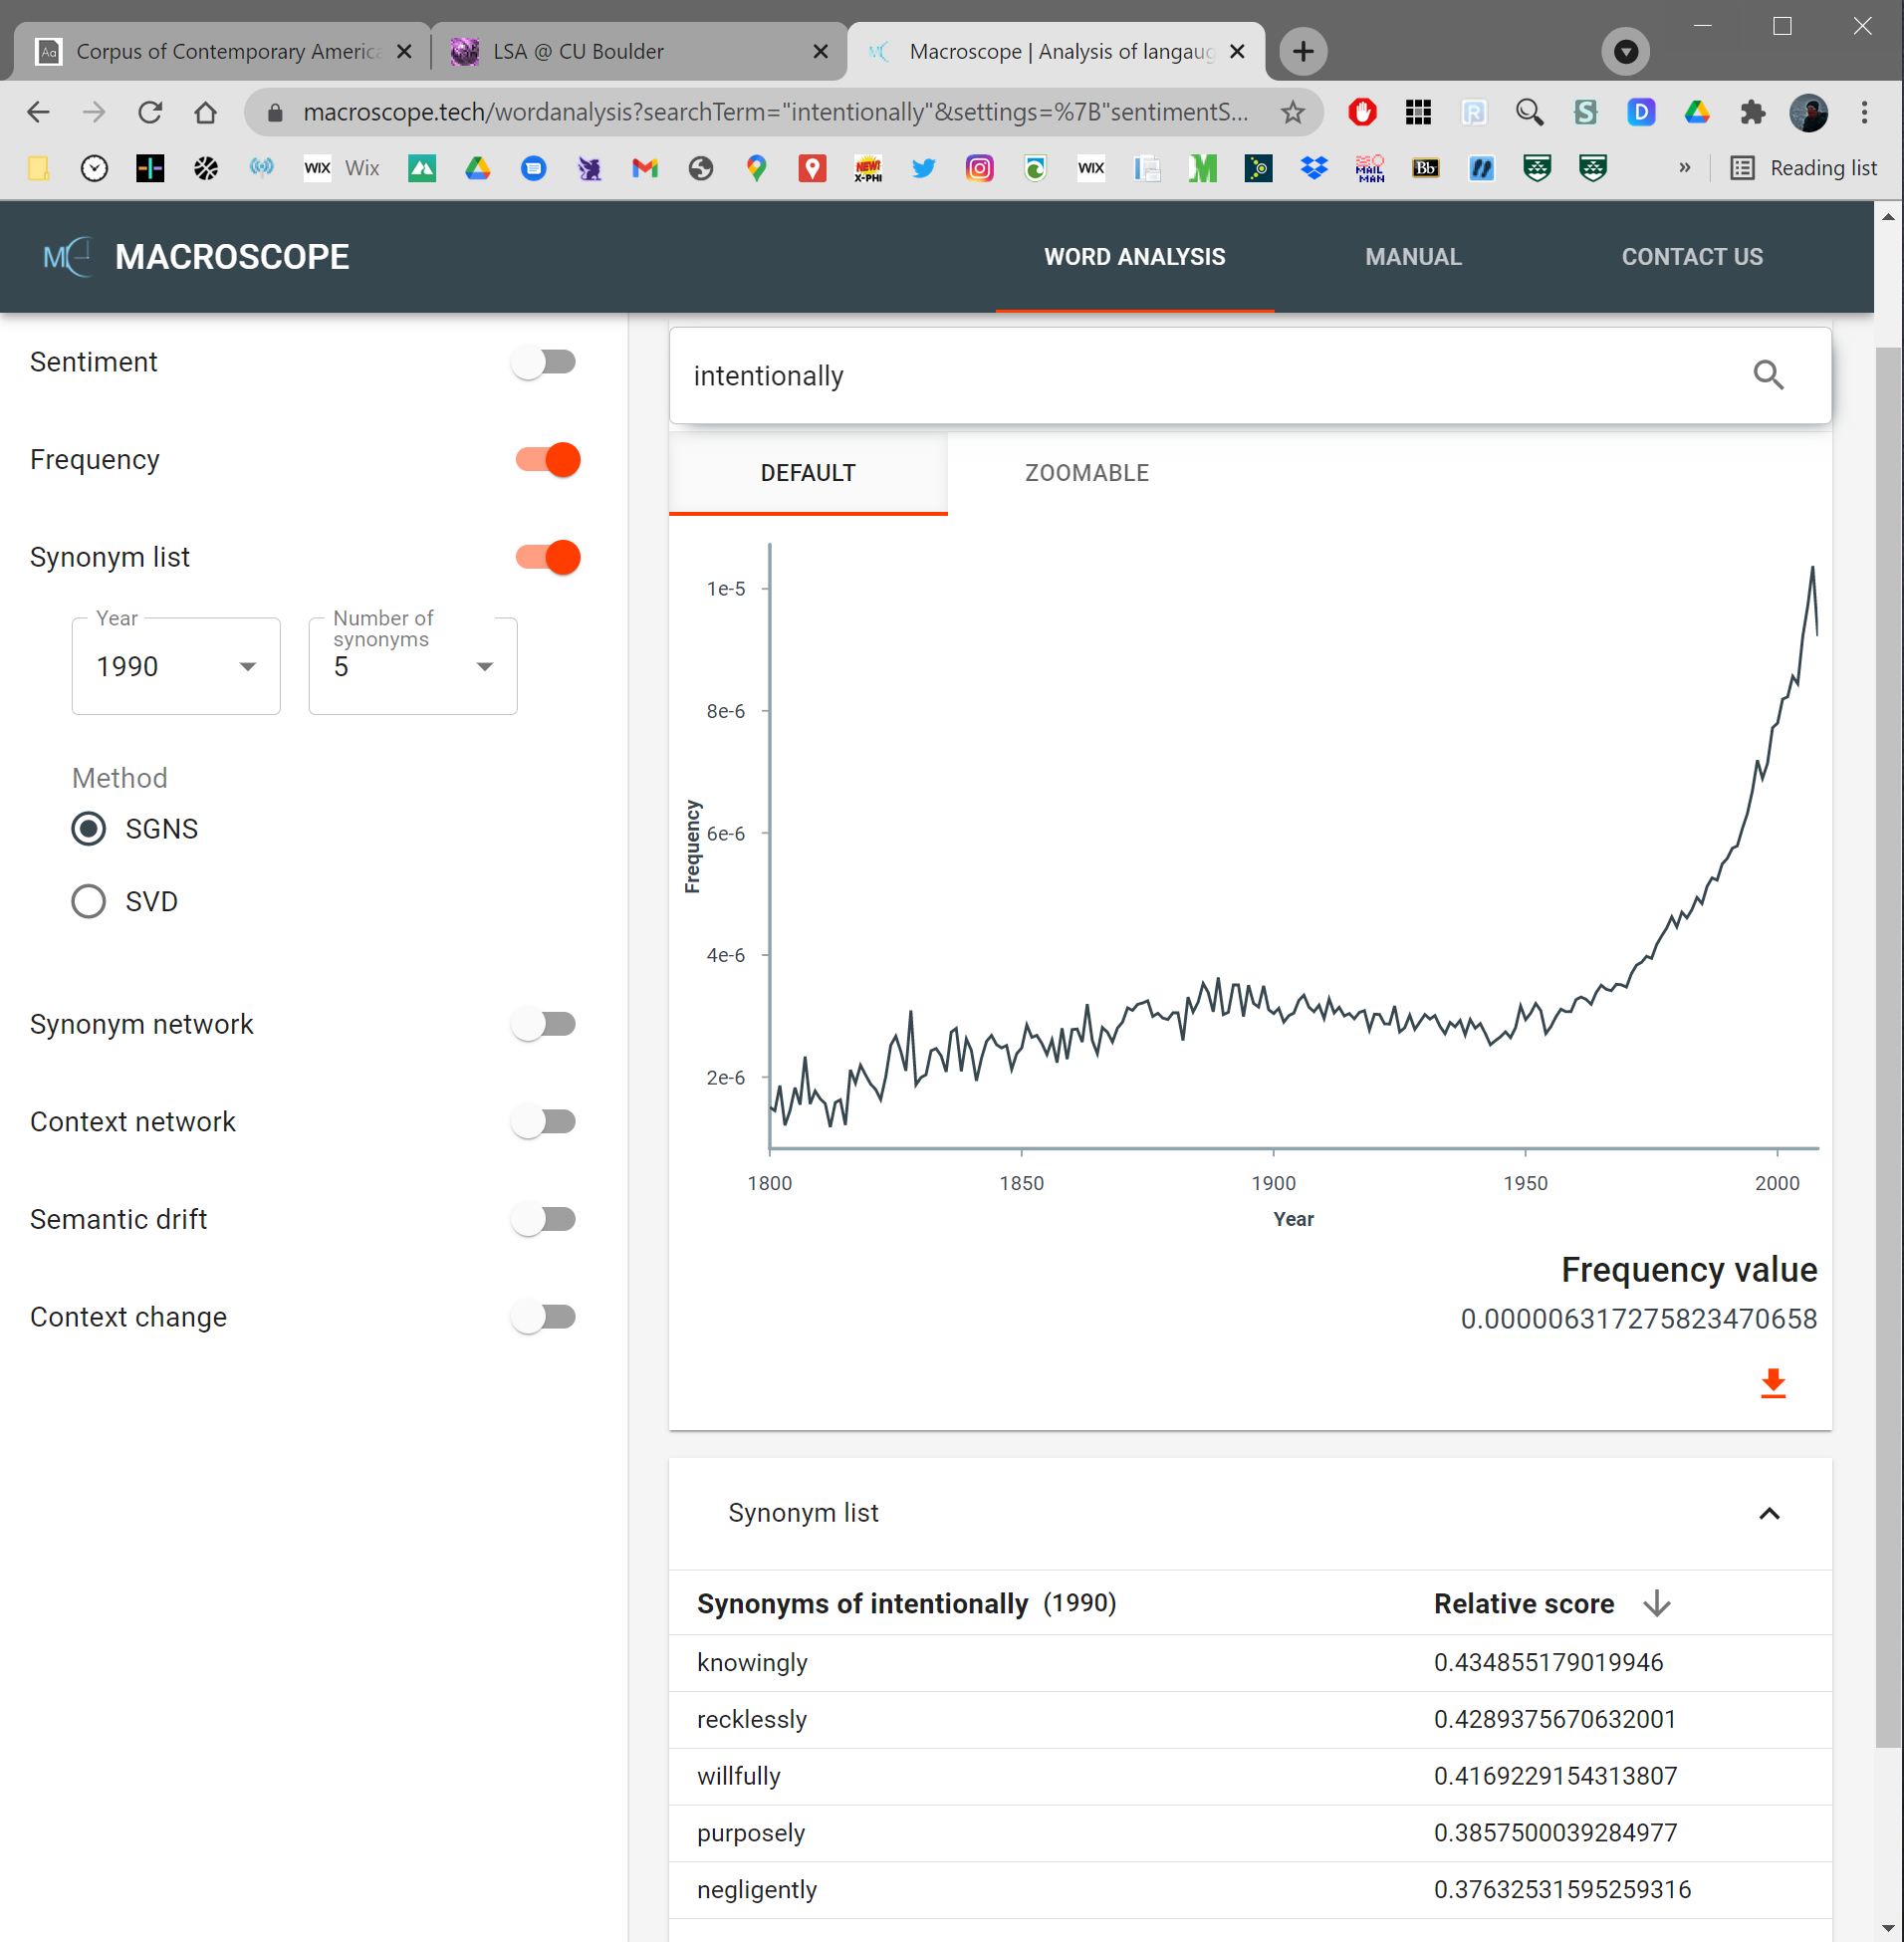

Slide 29
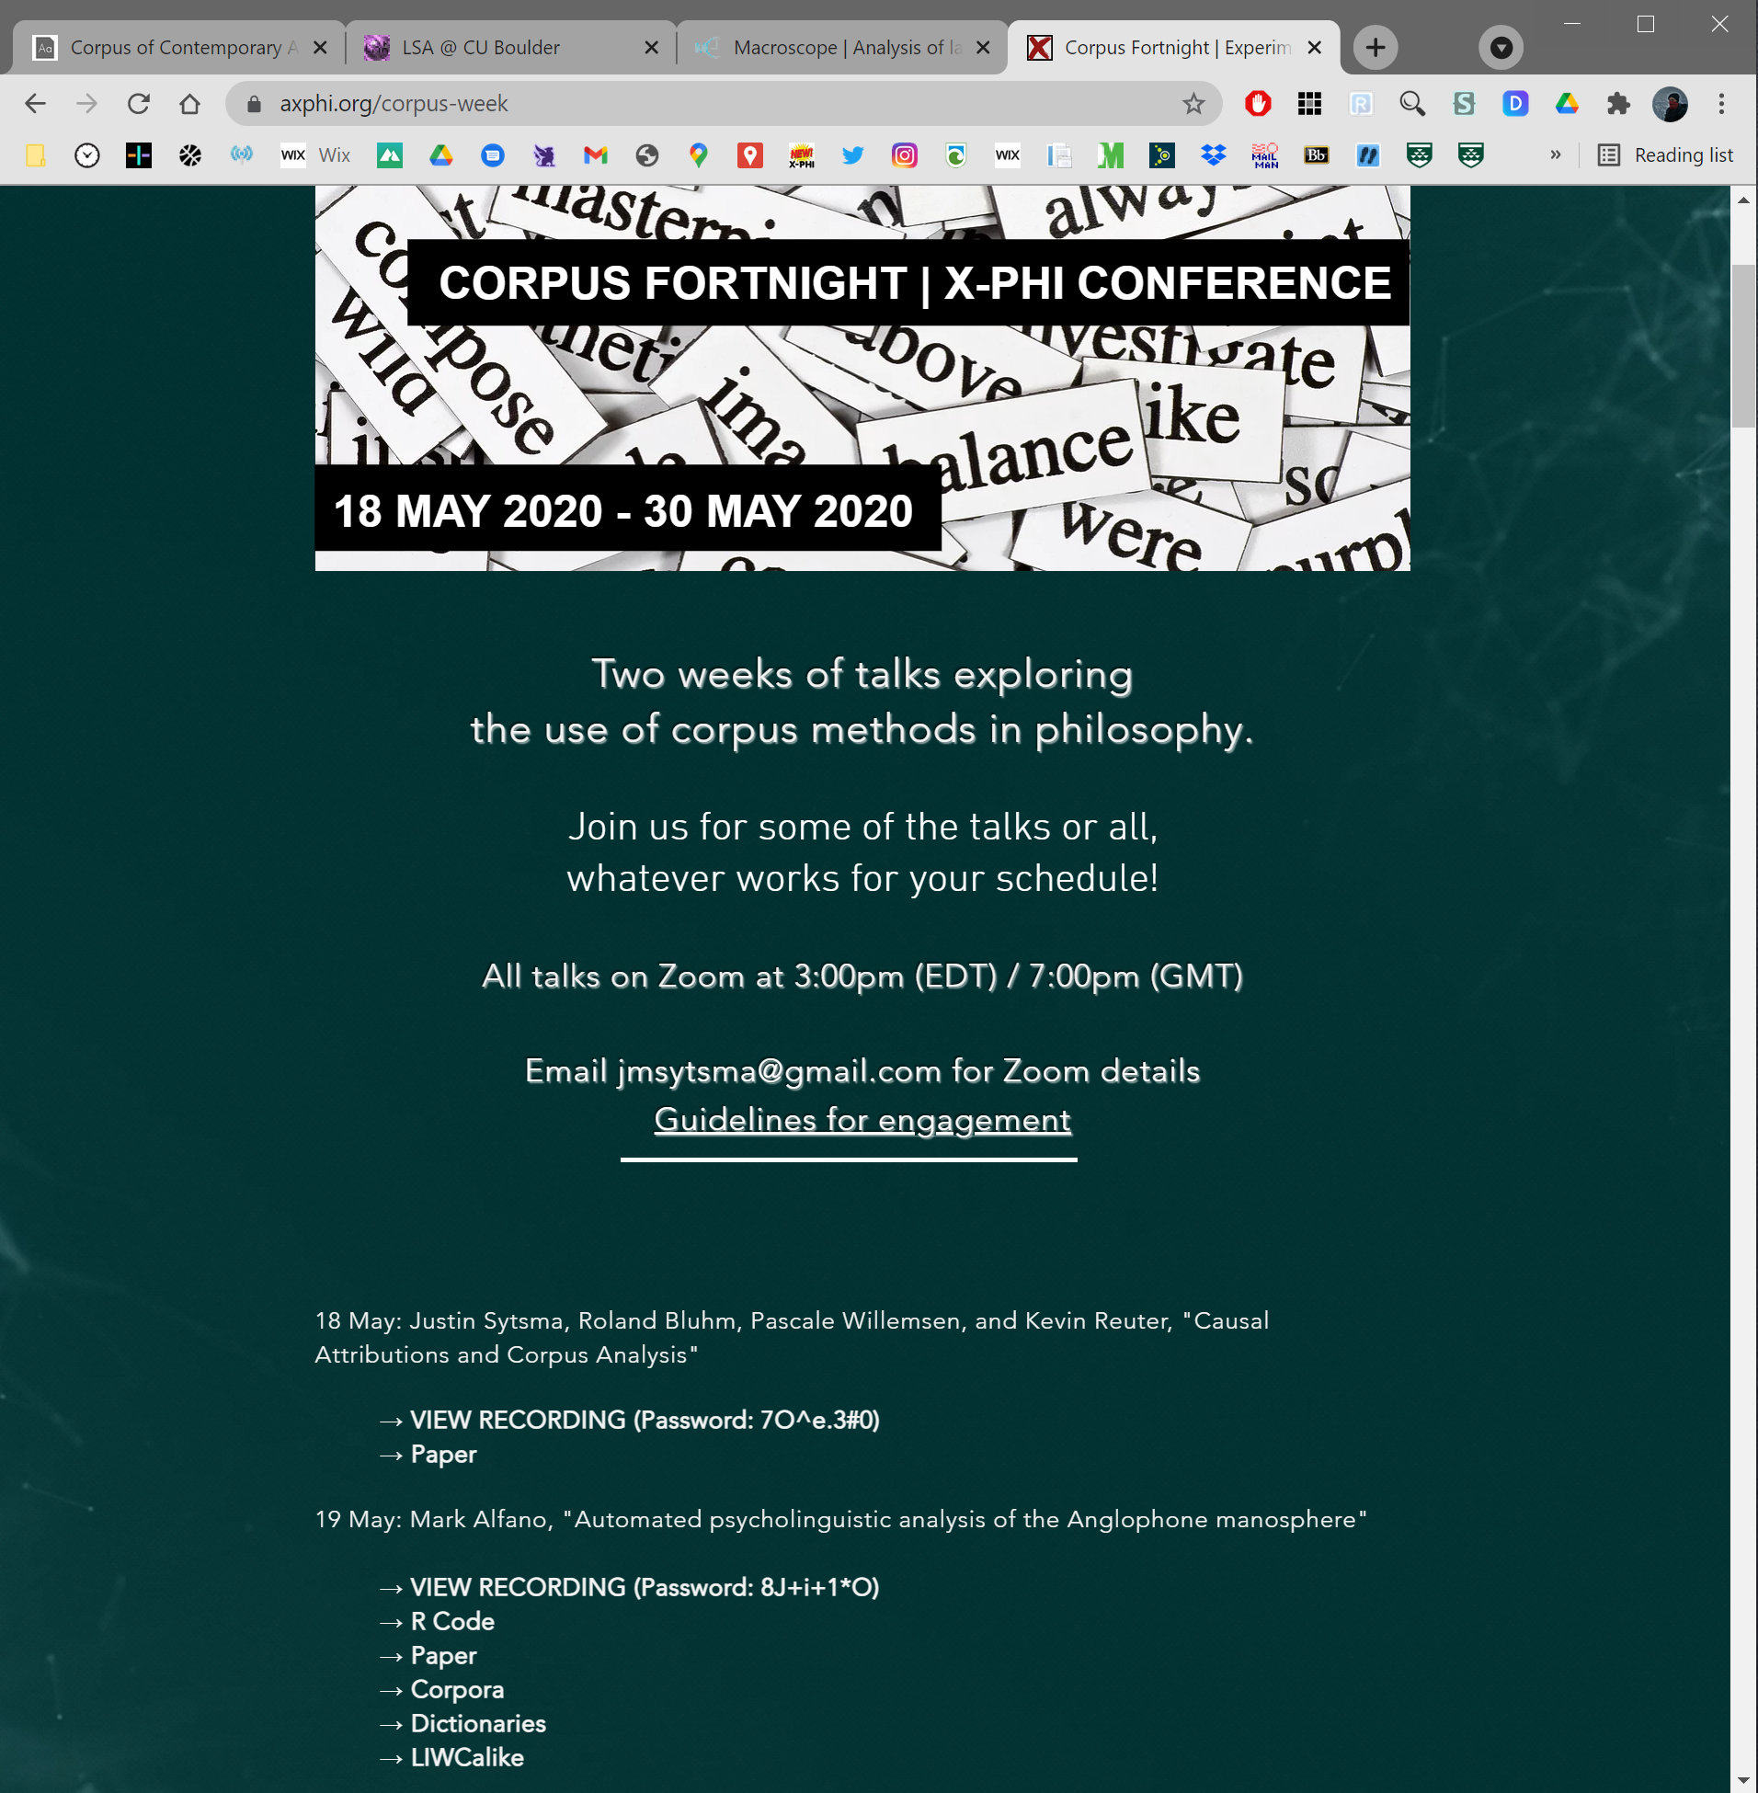
Some further examples…

Slide 30
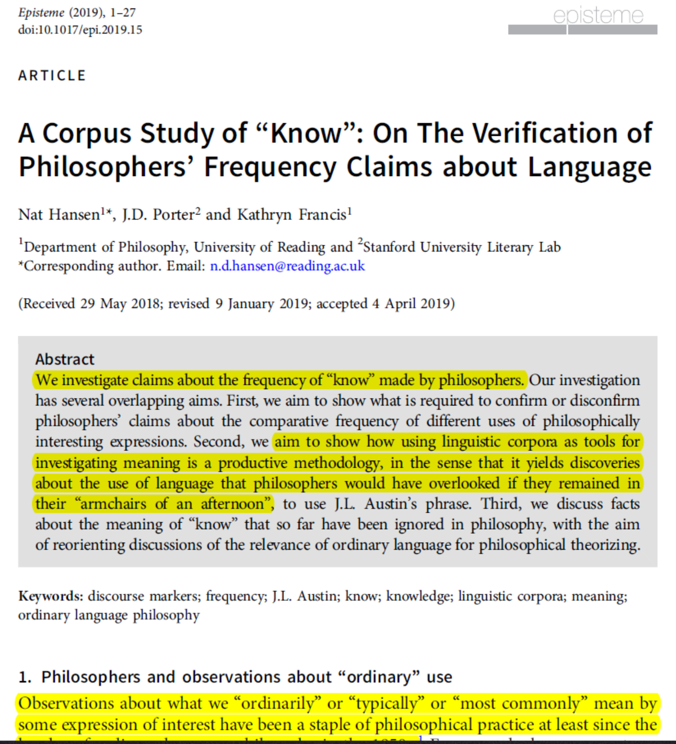
Corpus tools can be used for testing claims.
And they can be used for exploration.

Slide 31
“Observations about what we ‘ordinarily’ or
‘typically’ or ‘most commonly’ mean by some
expression of interest have been a staple of
philosophical practice at least since the
heyday of ordinary language philosophy
in the 1950s.” (1)
Includes philosophy claims about “know” talk:
“most of the time, outside of epistemology,
when we consider whether somebody knows
something, we are mainly interested in….
Similarly, when we say that someone does
not know something, typically we mean….”
(Bach 2005, 62-3)

Slide 32
“Observations about what we ‘ordinarily’ or
‘typically’ or ‘most commonly’ mean by some
expression of interest have been a staple of
philosophical practice at least since the
heyday of ordinary language philosophy
in the 1950s.” (1)
Includes philosophy claims about “know” talk:
“most of the time, outside of epistemology,
when we consider whether somebody knows
something, we are mainly interested in….
Similarly, when we say that someone does
not know something, typically we mean….”
(Bach 2005, 62-3)

Slide 33
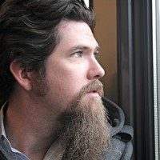
What would justify philosophers’ frequency
claims about how people ordinarily talk?
Fortunately for the philosopher of language, however, there now exist resources to investigate objective frequencies of occurrences of linguistic expressions, namely linguistic corpora, which are organized bodies of text, purpose-built for answering linguistic questions, such as what the comparative frequencies of various expressions are. (2)

Slide 34
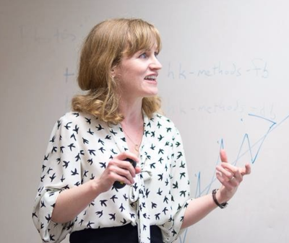
Note use of COCA by Nagel (2014) to justify
that investigating “know” (knowledge) is of
central importance.
In spoken English [in COCA] ‘know’… [figures] as the sixth… most commonly used [verb]…. Spoken English is deeply invested in knowing…. To be fair, some of the conversational traffic in ‘know’ is coming from fixed phrases, like – you know – invitations to conversational partners to make some inference, or – I know – indications that you are accepting what conversational partners are saying. But even after we strip out those formulaic uses, the database’s randomly sampled conversations remain thickly larded with genuine references to knowing….

Slide 35
Note use of COCA by Nagel (2014) to justify
that investigating “know” (knowledge) is of
central importance.
In spoken English [in COCA] ‘know’… [figures] as the sixth… most commonly used [verb]…. Spoken English is deeply invested in knowing…. To be fair, some of the conversational traffic in ‘know’ is coming from fixed phrases, like – you know – invitations to conversational partners to make some inference, or – I know – indications that you are accepting what conversational partners are saying. But even after we strip out those formulaic uses, the database’s randomly sampled conversations remain thickly larded with genuine references to knowing….

Slide 36
Note use of COCA by Nagel (2014) to justify
that investigating “know” (knowledge) is of
central importance.
In spoken English [in COCA] ‘know’… [figures] as the sixth… most commonly used [verb]…. Spoken English is deeply invested in knowing…. To be fair, some of the conversational traffic in ‘know’ is coming from fixed phrases, like – you know – invitations to conversational partners to make some inference, or – I know – indications that you are accepting what conversational partners are saying. But even after we strip out those formulaic uses, the database’s randomly sampled conversations remain thickly larded with genuine references to knowing….

Slide 37
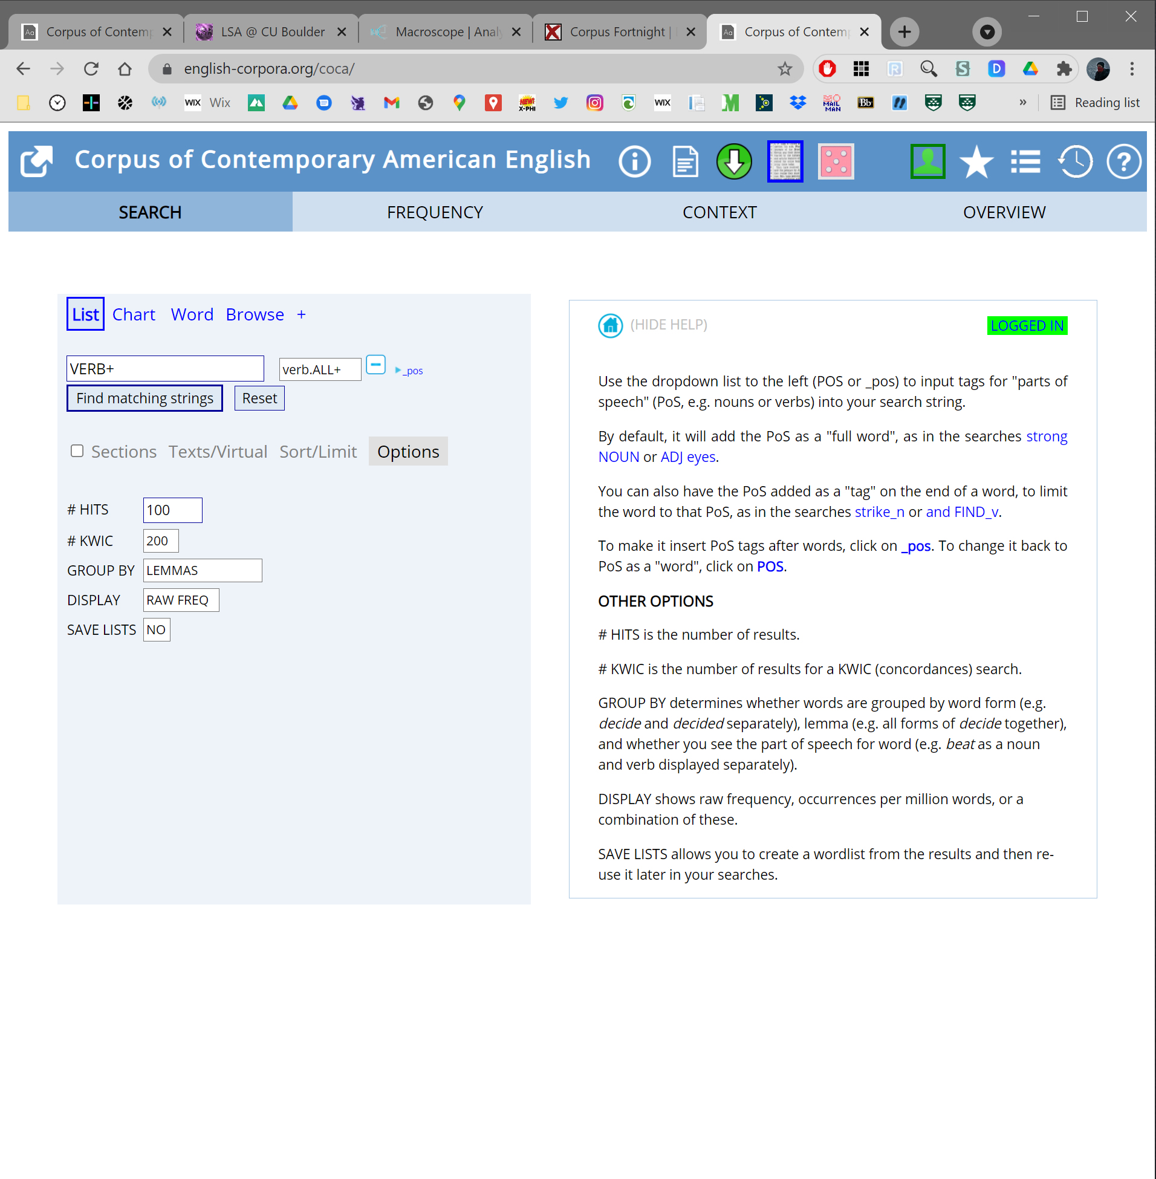

Slide 38
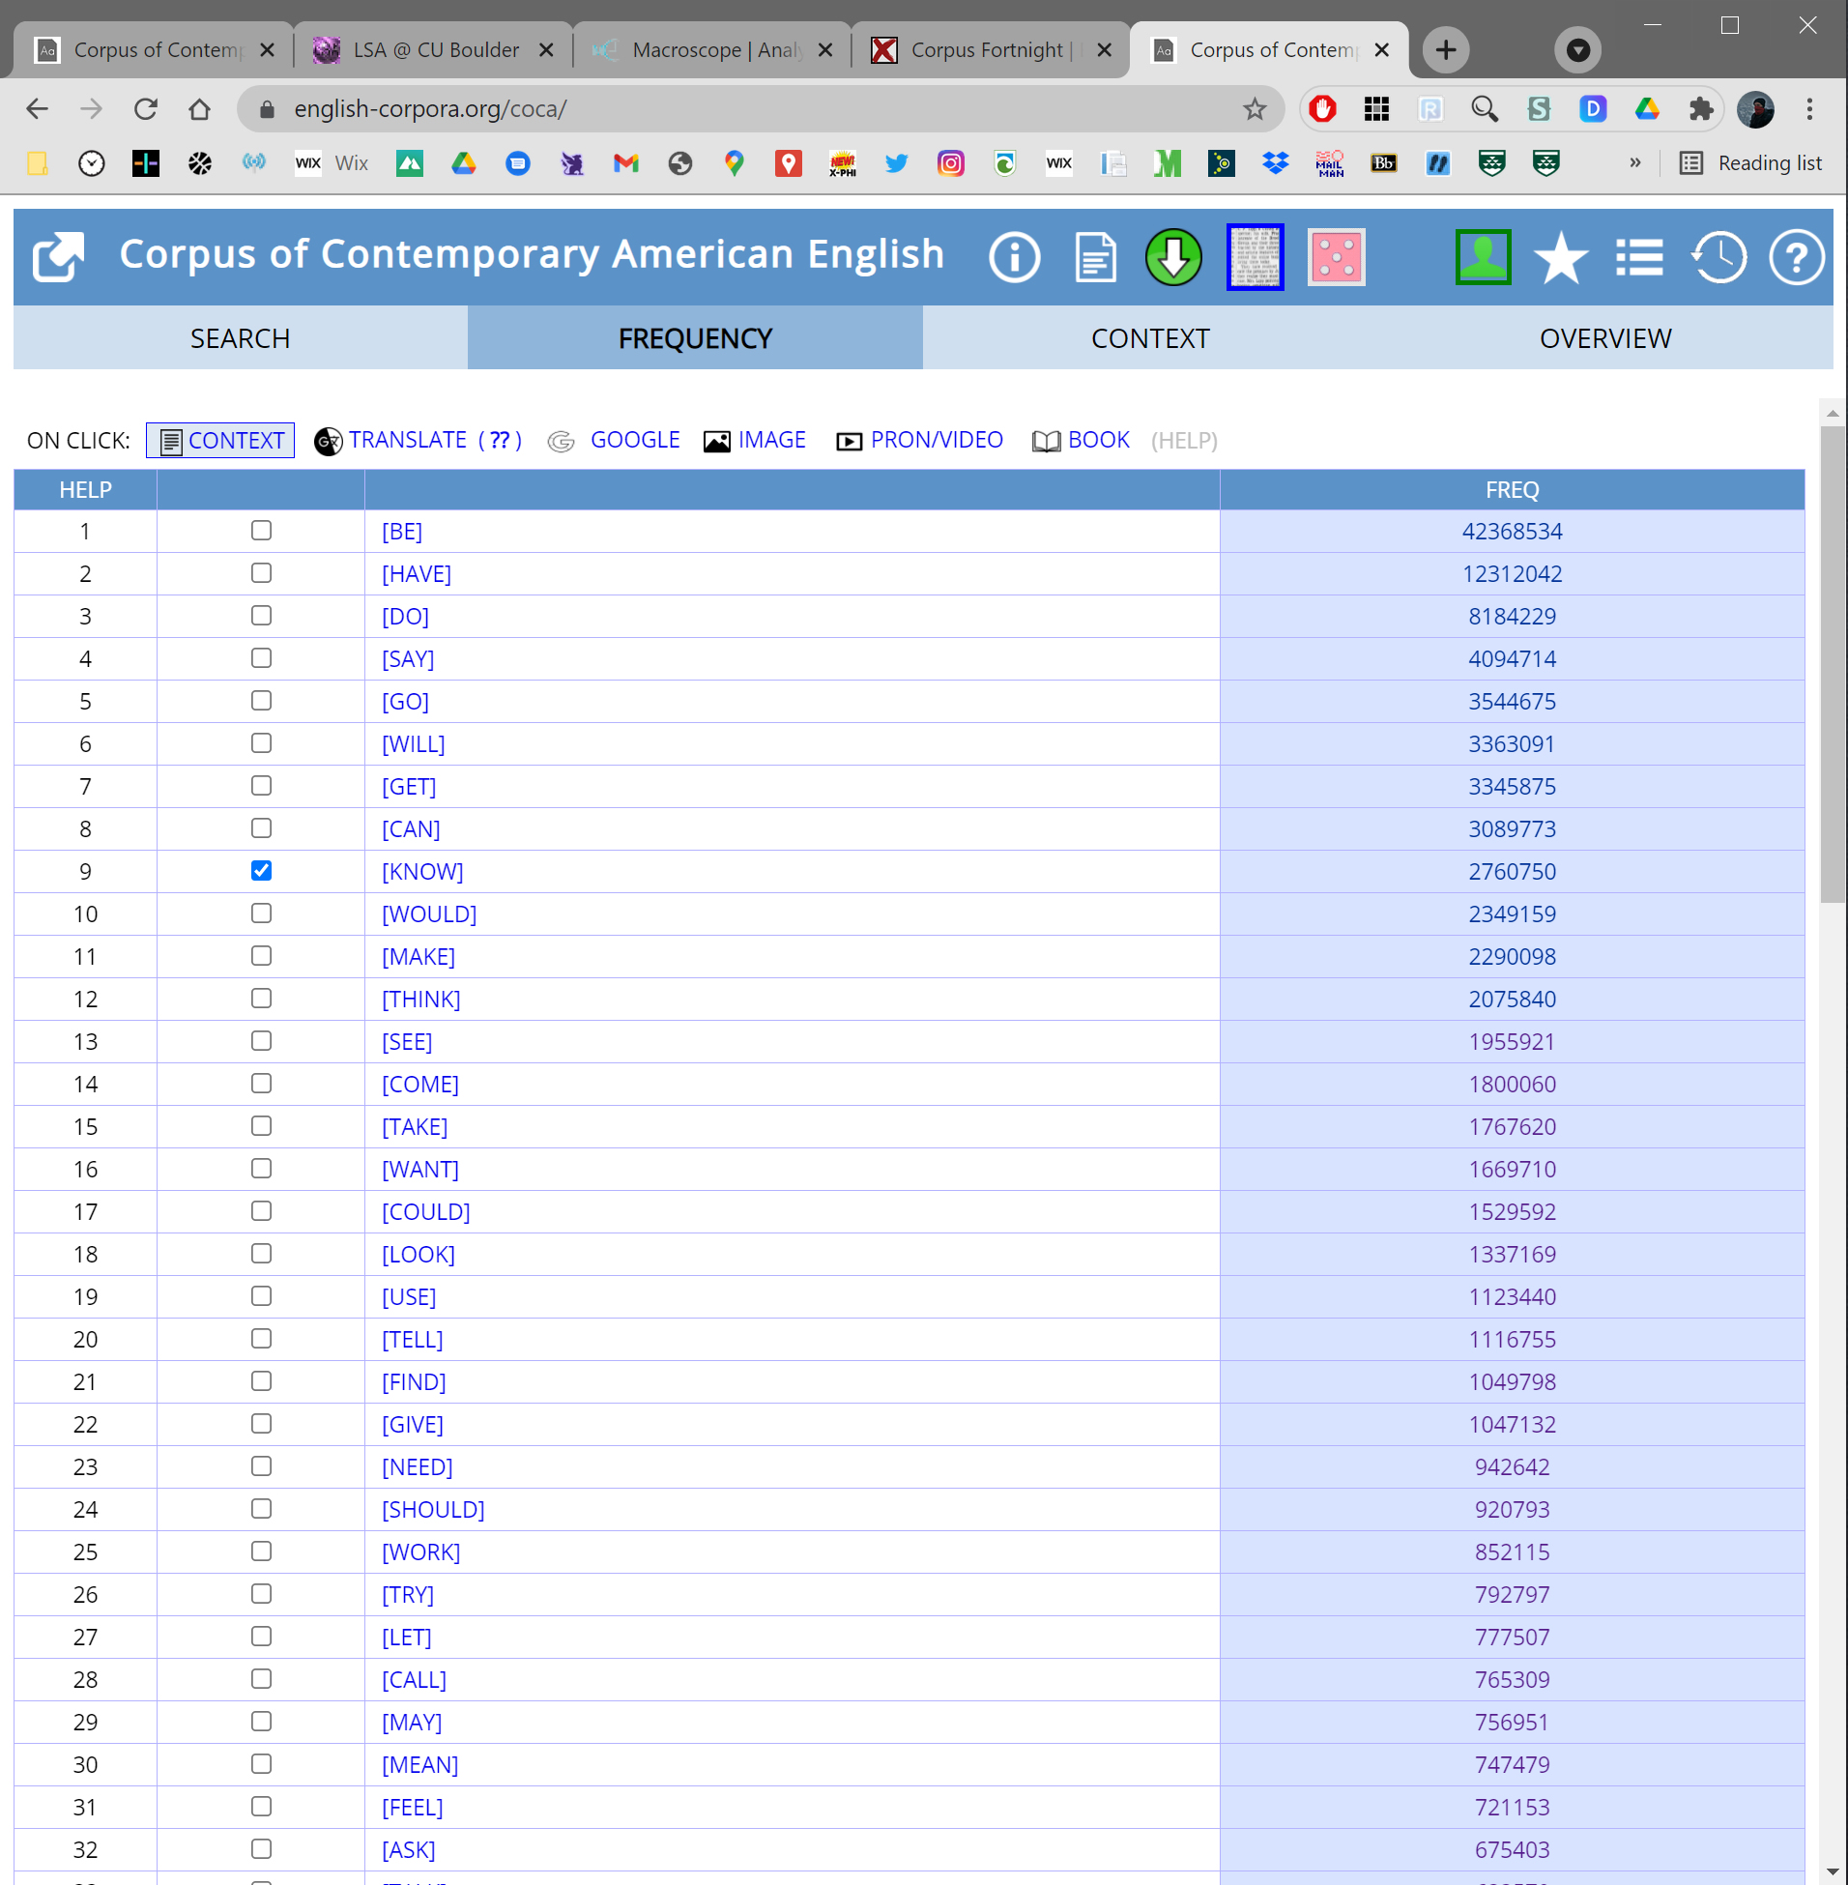

Slide 39
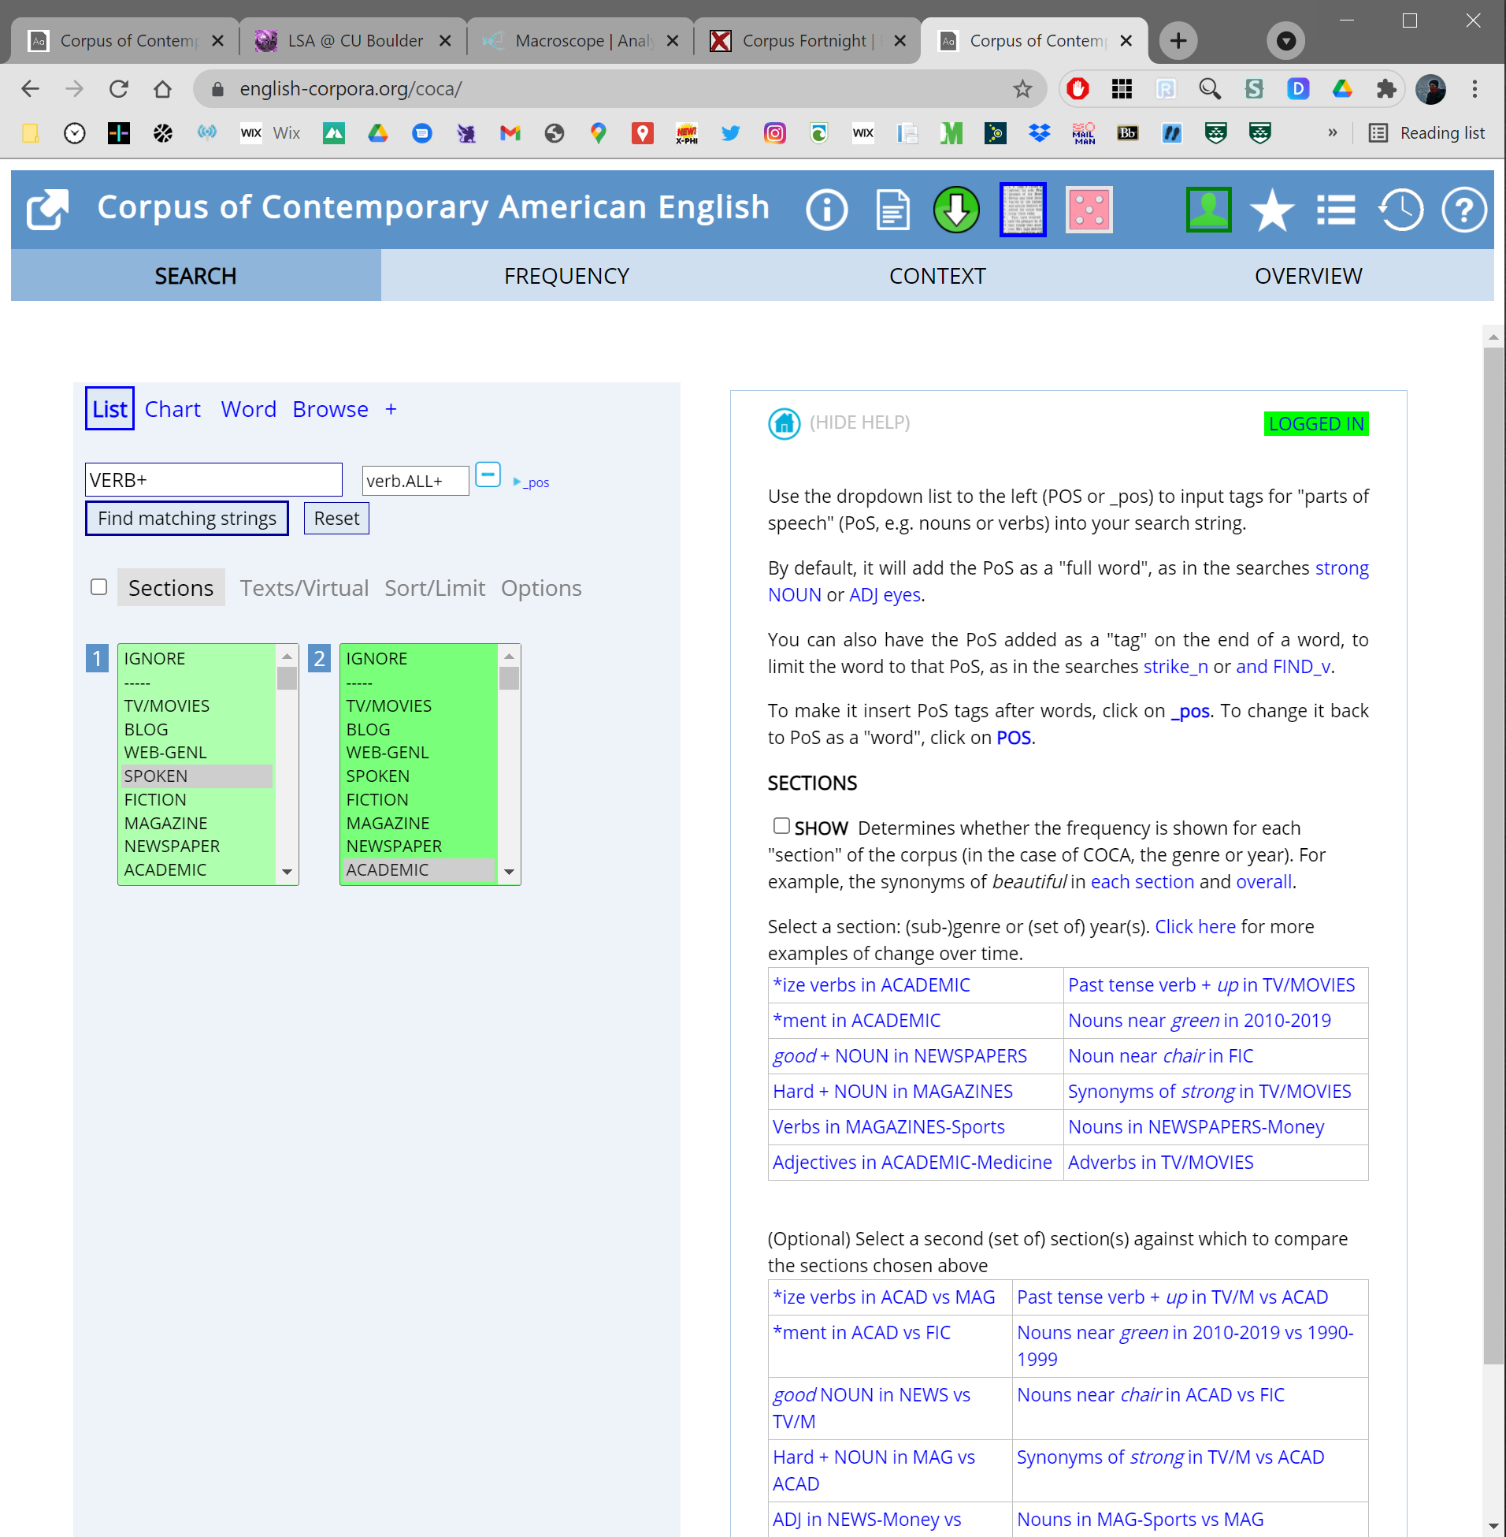

Slide 40
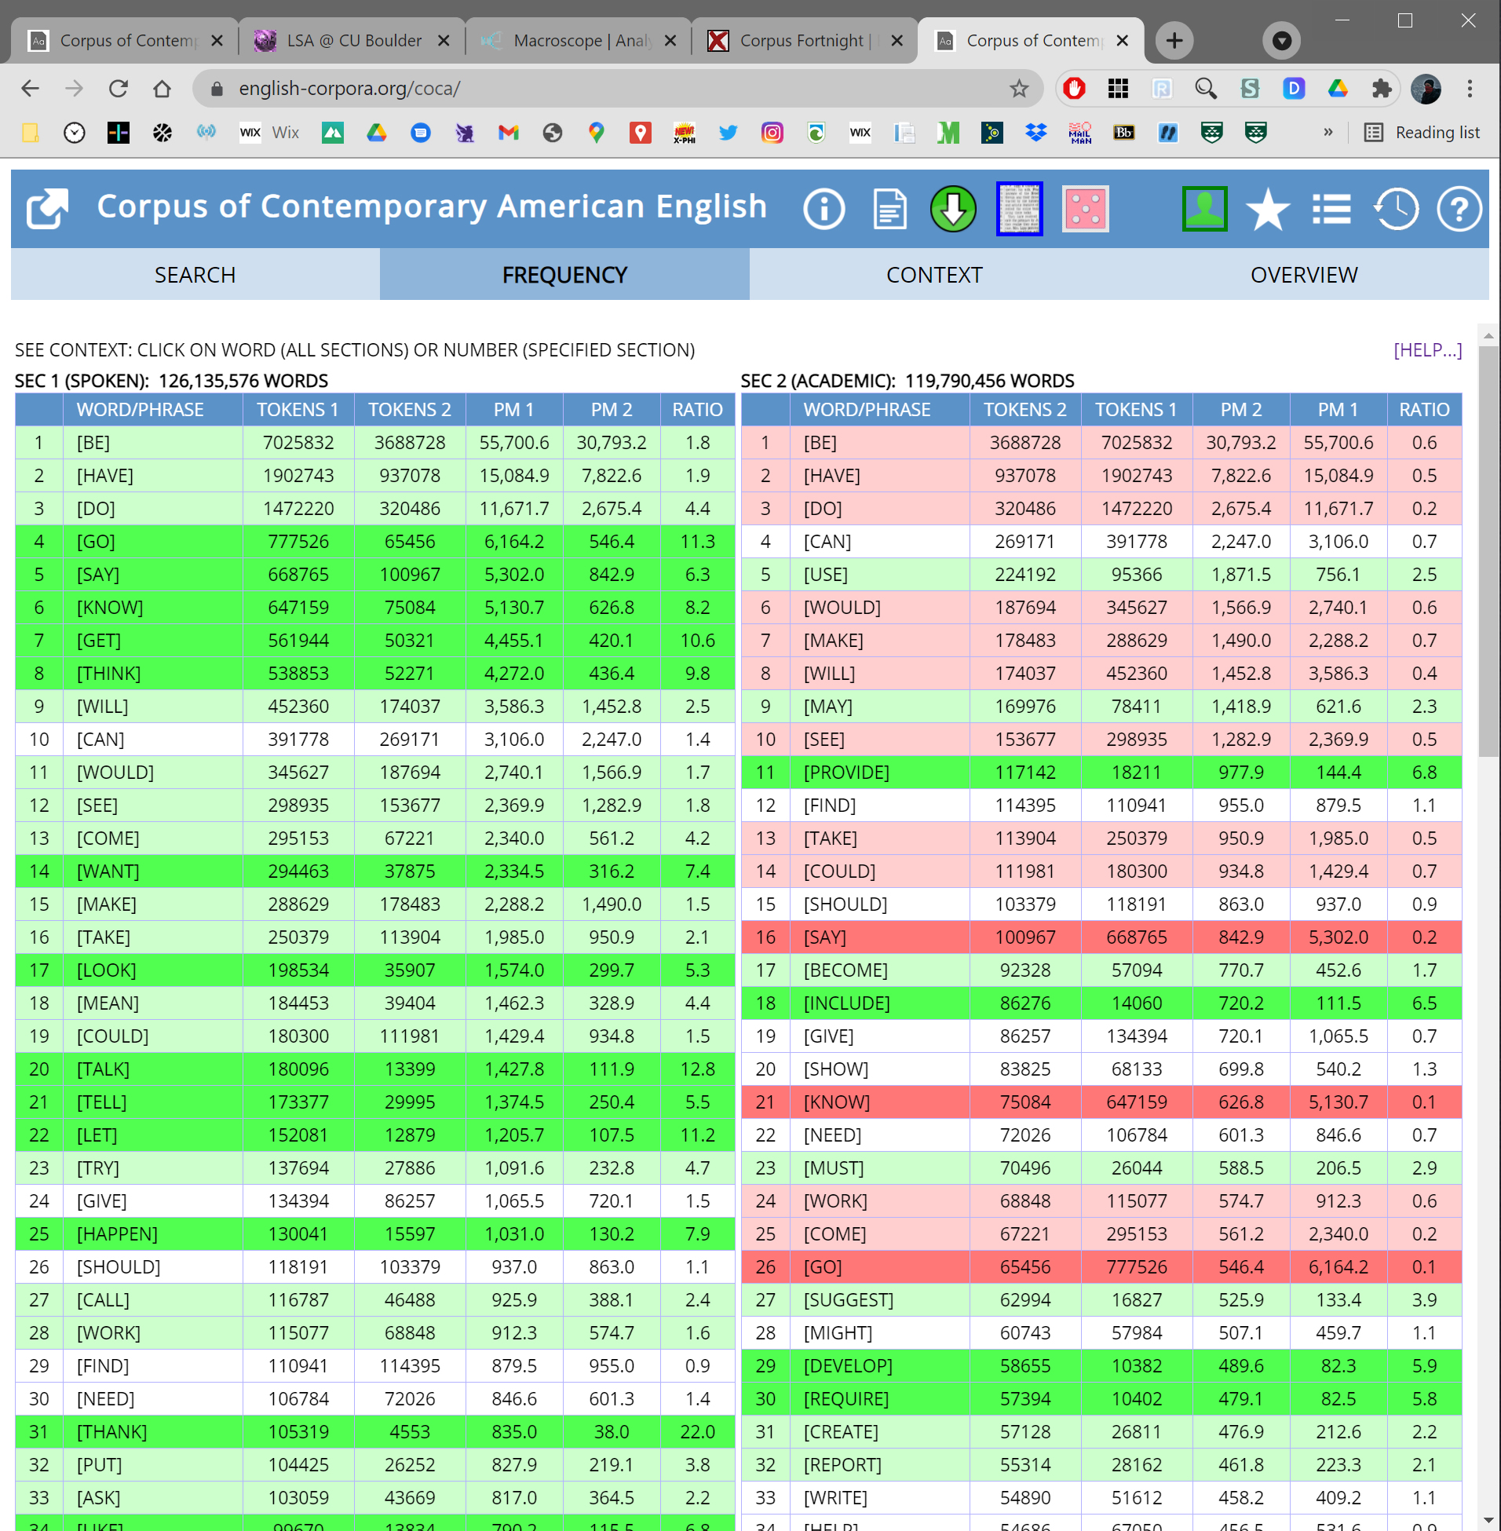

Slide 41
Striking difference!
How much is due to Nagel’s “fixed phrases” –
i.e., “discourse markers, which, you know,
probably don’t occur as frequently in
academic writing” (4)?
Random samples from COCA and code
concordance lines:
Spoken: 254/500 = discourse markers
Academic: 8/500 = discourse markers
(all direct quotes)

Slide 42
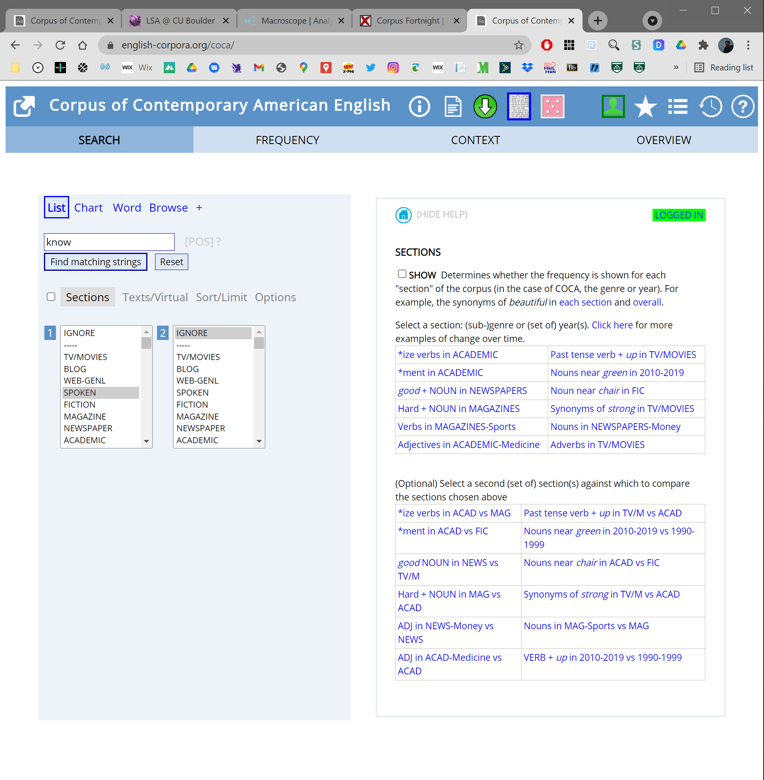

Slide 43


Slide 44
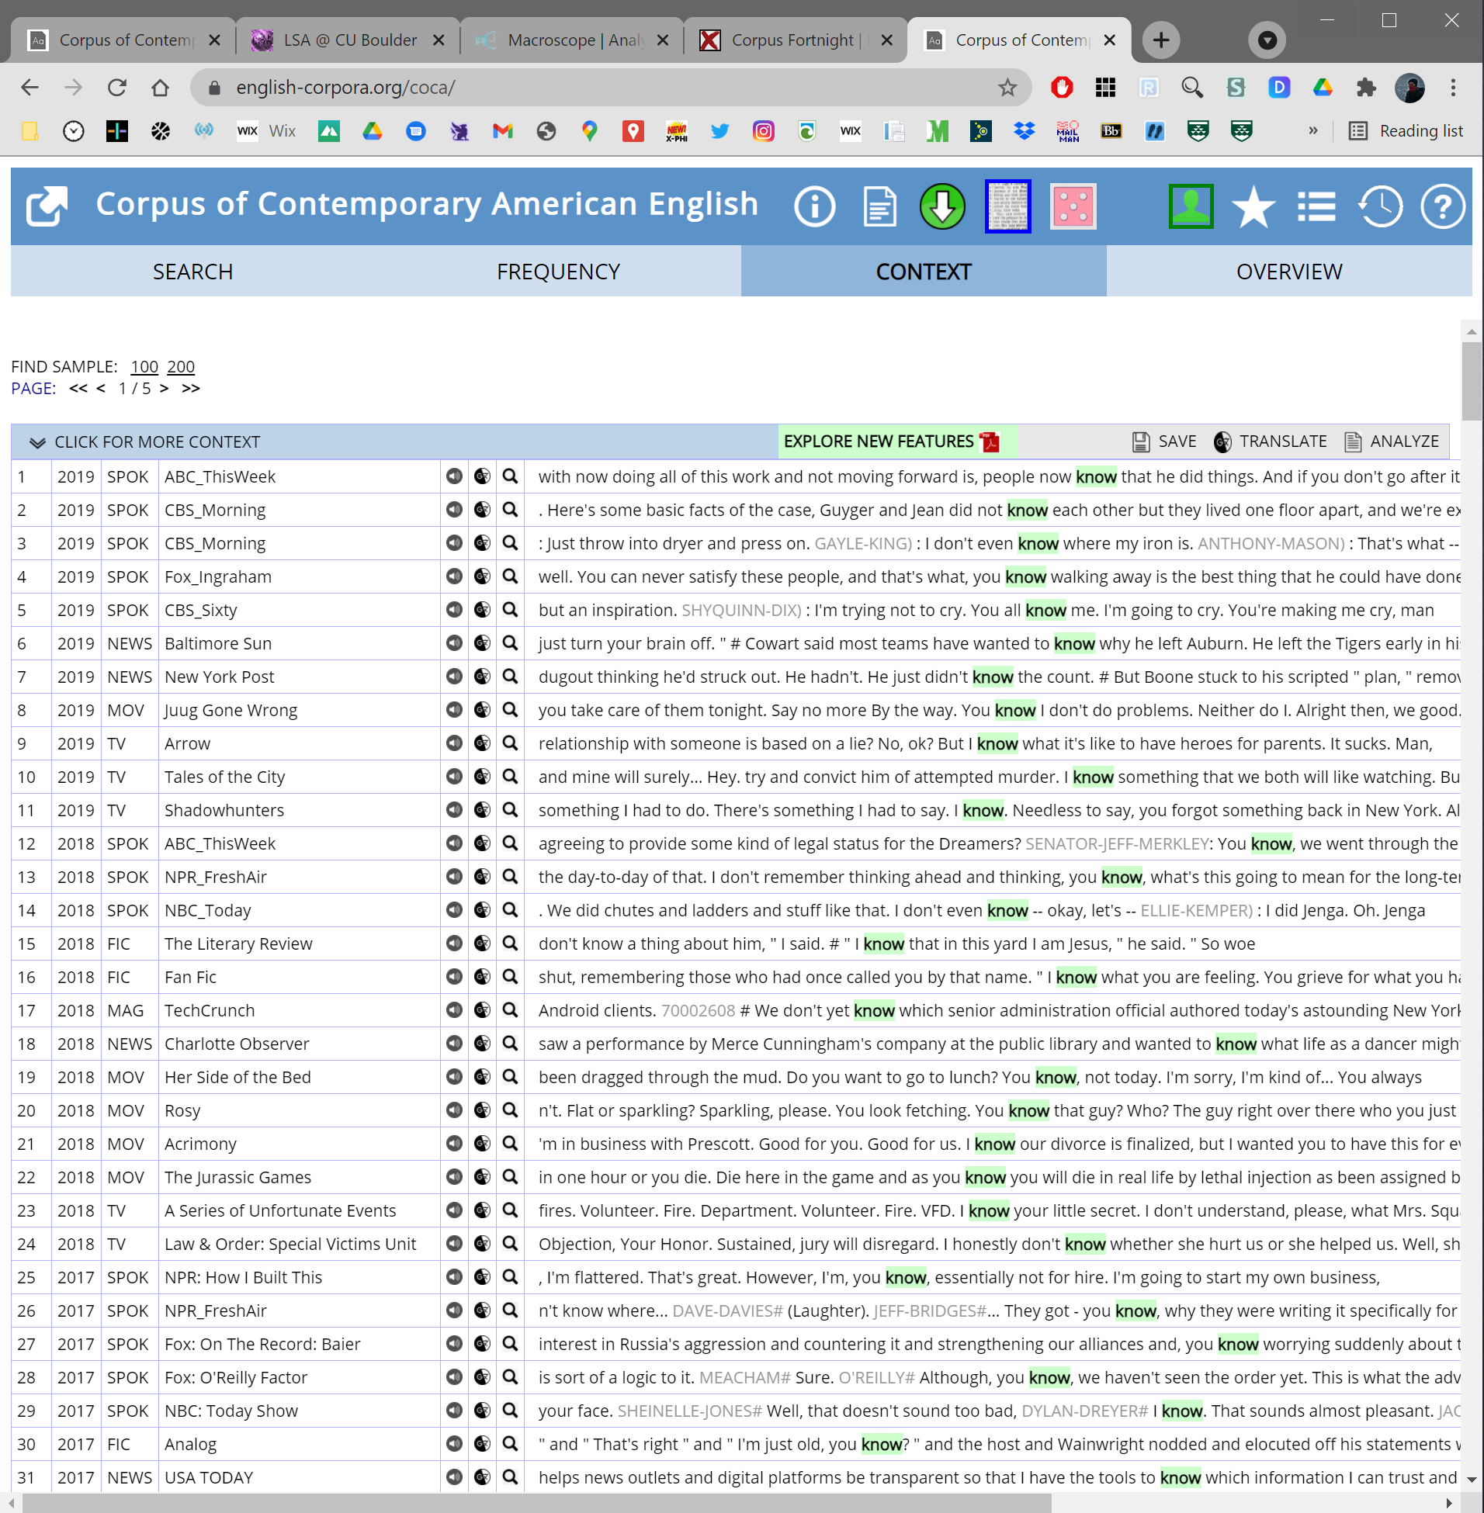

Slide 45
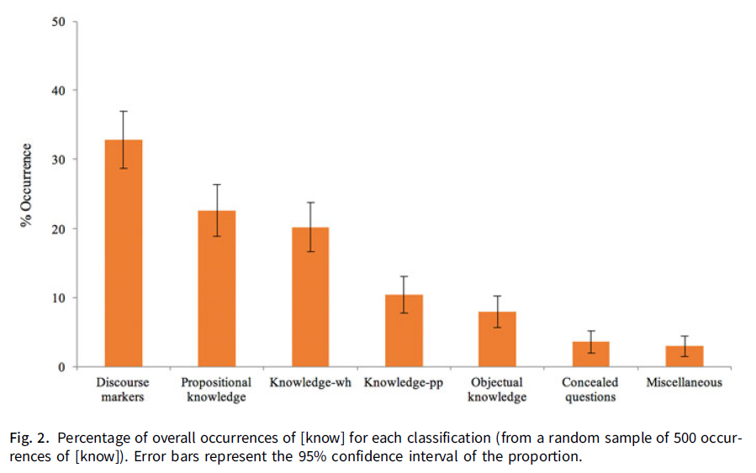
“genuine references to knowing”?
“I know that it’s sunny”;
“I know it’s sunny”
“I know when it closes”;
“I know who killed him”
“…at a site now known
as Blackbeard’s Point…”
“For all
I know…”
“Kim knows the
governor of CA”
“I know her”;
“I know Nat”

Slide 46

In addition to addressing general worries about the reliability and verifiability of armchair frequency judgments, looking at samples drawn from linguistic corpora can reveal new facts about the way linguistic expressions are used that have so far flown below philosophers’ radar. For example, while philosophers have devoted a great deal of attention to knowledge-that, knowledge-wh, and objectual knowledge, so far they have not discussed cases of knowledge + prepositional phrase complements.
A cursory look at occurrences of [know] in COCA reveals that such occurrences are roughly as frequent as occurrences of objectual knowledge. And most striking of all, philosophers have so far not discussed discourse marking uses of [know], even though such uses are the most frequent occurrences of [know] in COCA. (22)

Slide 47
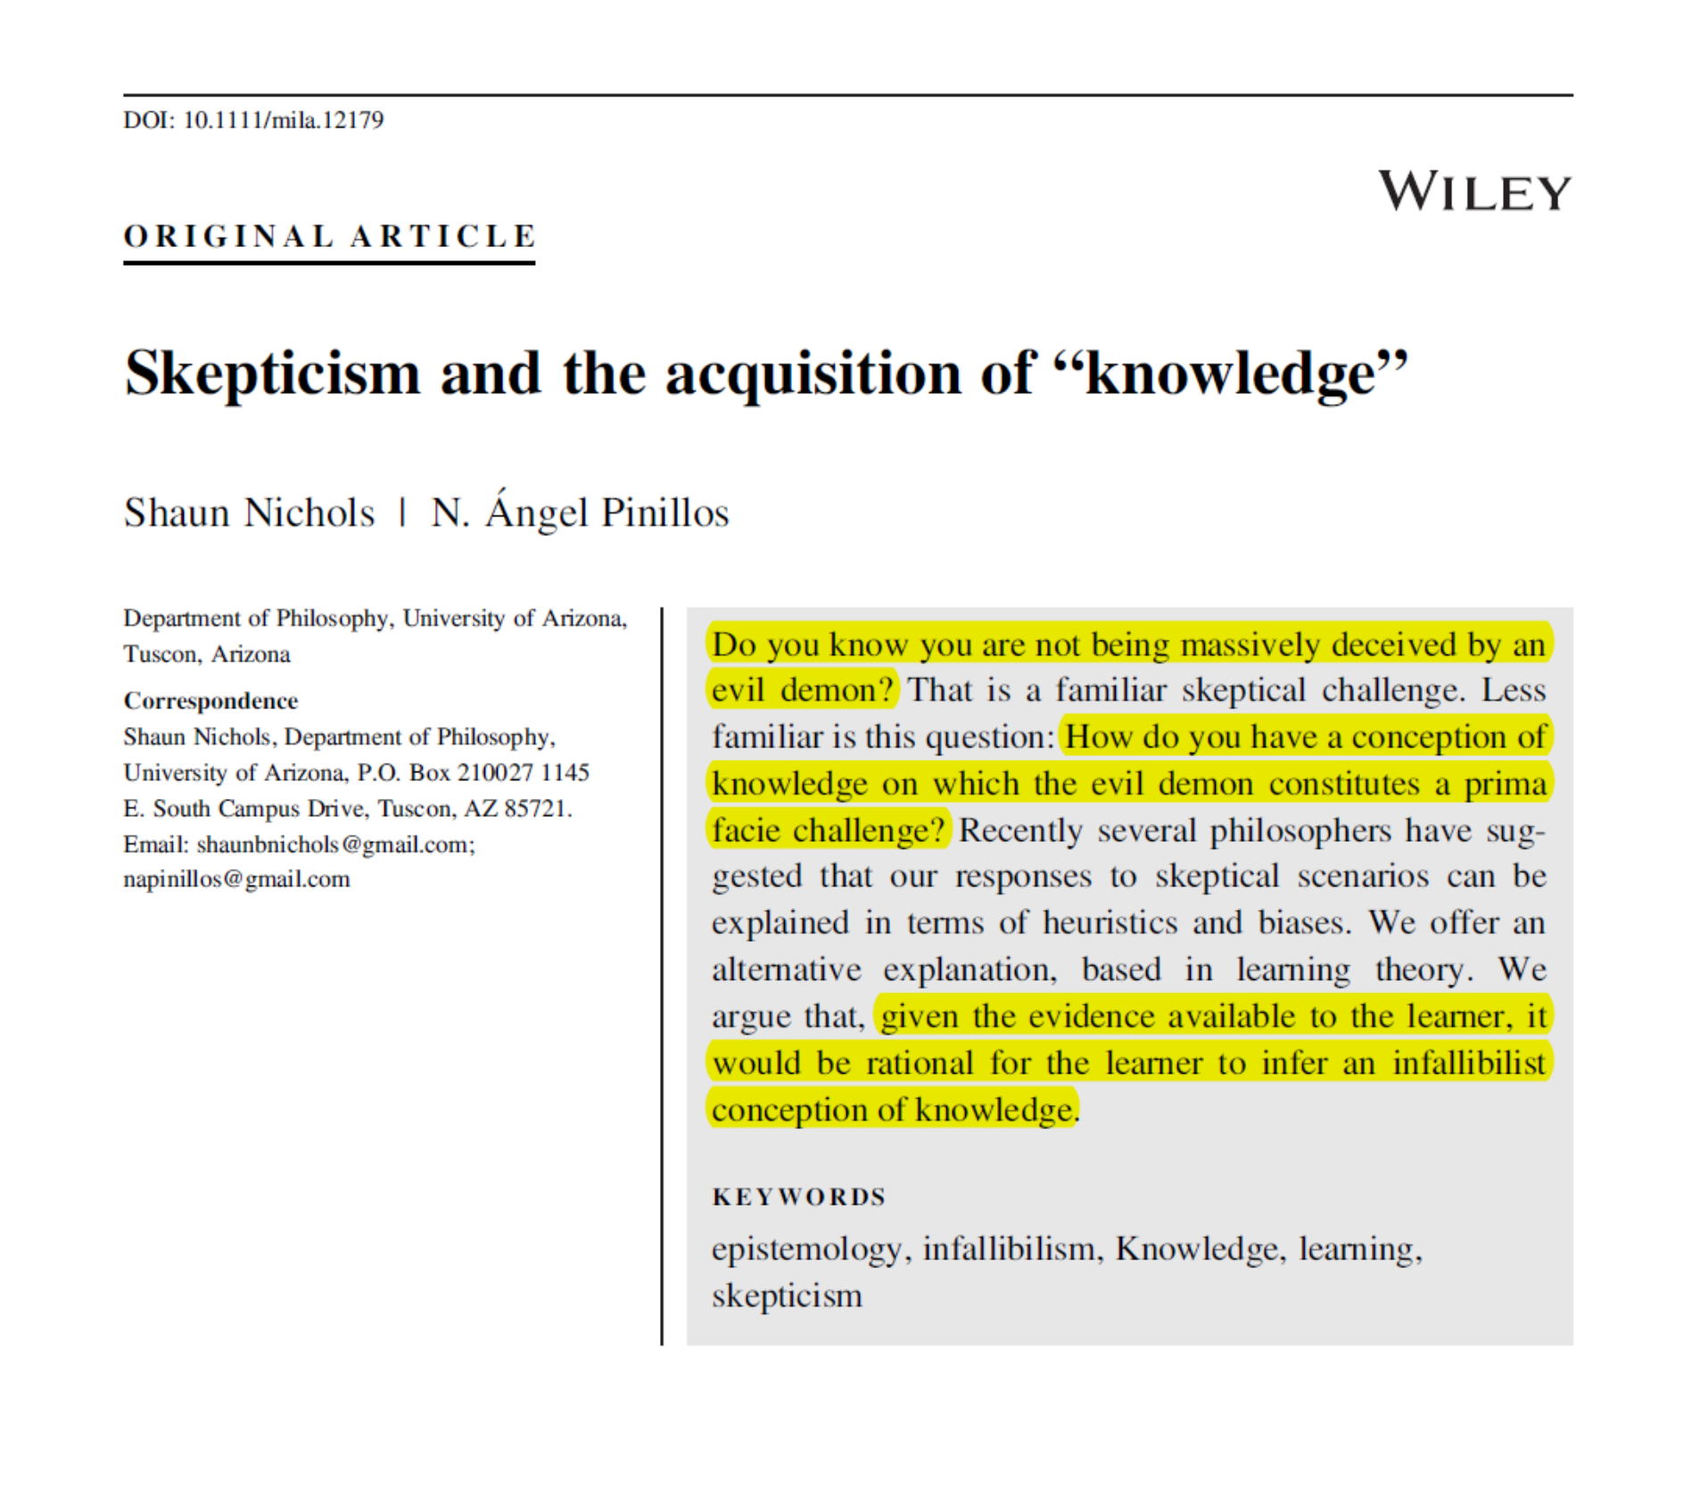
Another example looking at “know,” this
time using a specialty corpus (CHILDES).

Slide 48
Rough idea: skepticism is naturally compelling
because we tend to have an infallibilist concept
of knowledge, such that if S knows P, then S’s
epistemic state guarantees P.
Call on learning theory and corpus evidence
to provide support for Folk Infallibilism:
“If we can determine the conception of knowledge
that a child should learn, given the evidence,
that will provide some reason to think that this
is the conception he/she does learn.” (404)

Slide 49
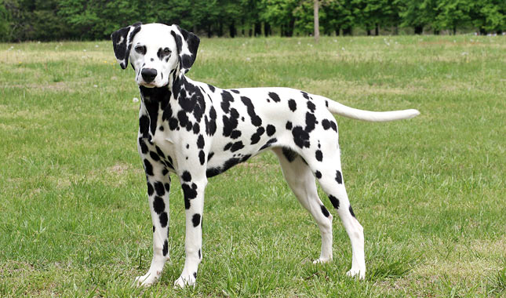


The Size Principle
Xu and Tenenbaum (2007): Children only need
a few positive examples to learn the word “dog.”
Compatible with animal, living being, etc.,
but don’t need negative instances. Why?!

Slide 50
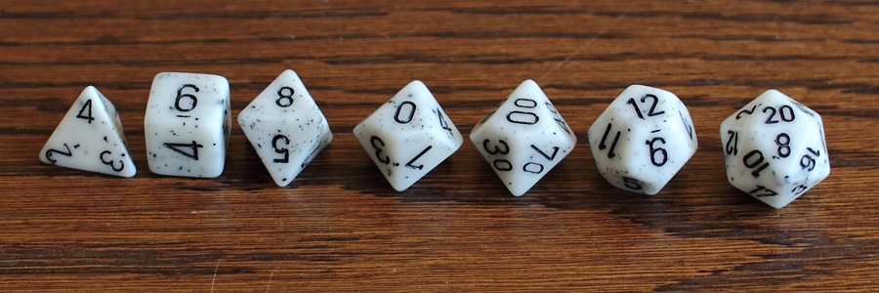
?
4, 5, 2, 5, 6, 8, 1, 8, 10, 3?
2, 1, 4, 2, 2, 3, 4, 4, 2, 1?

Slide 51
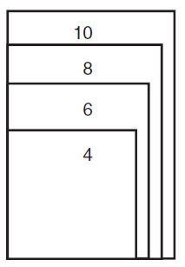
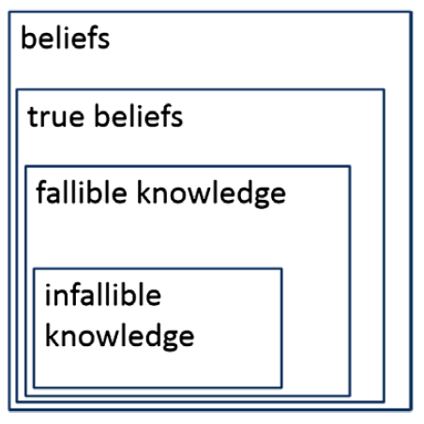
Smaller hypotheses that are consistent
with the data are significantly preferred to
larger hypotheses.
What evidence do children get?

Slide 52
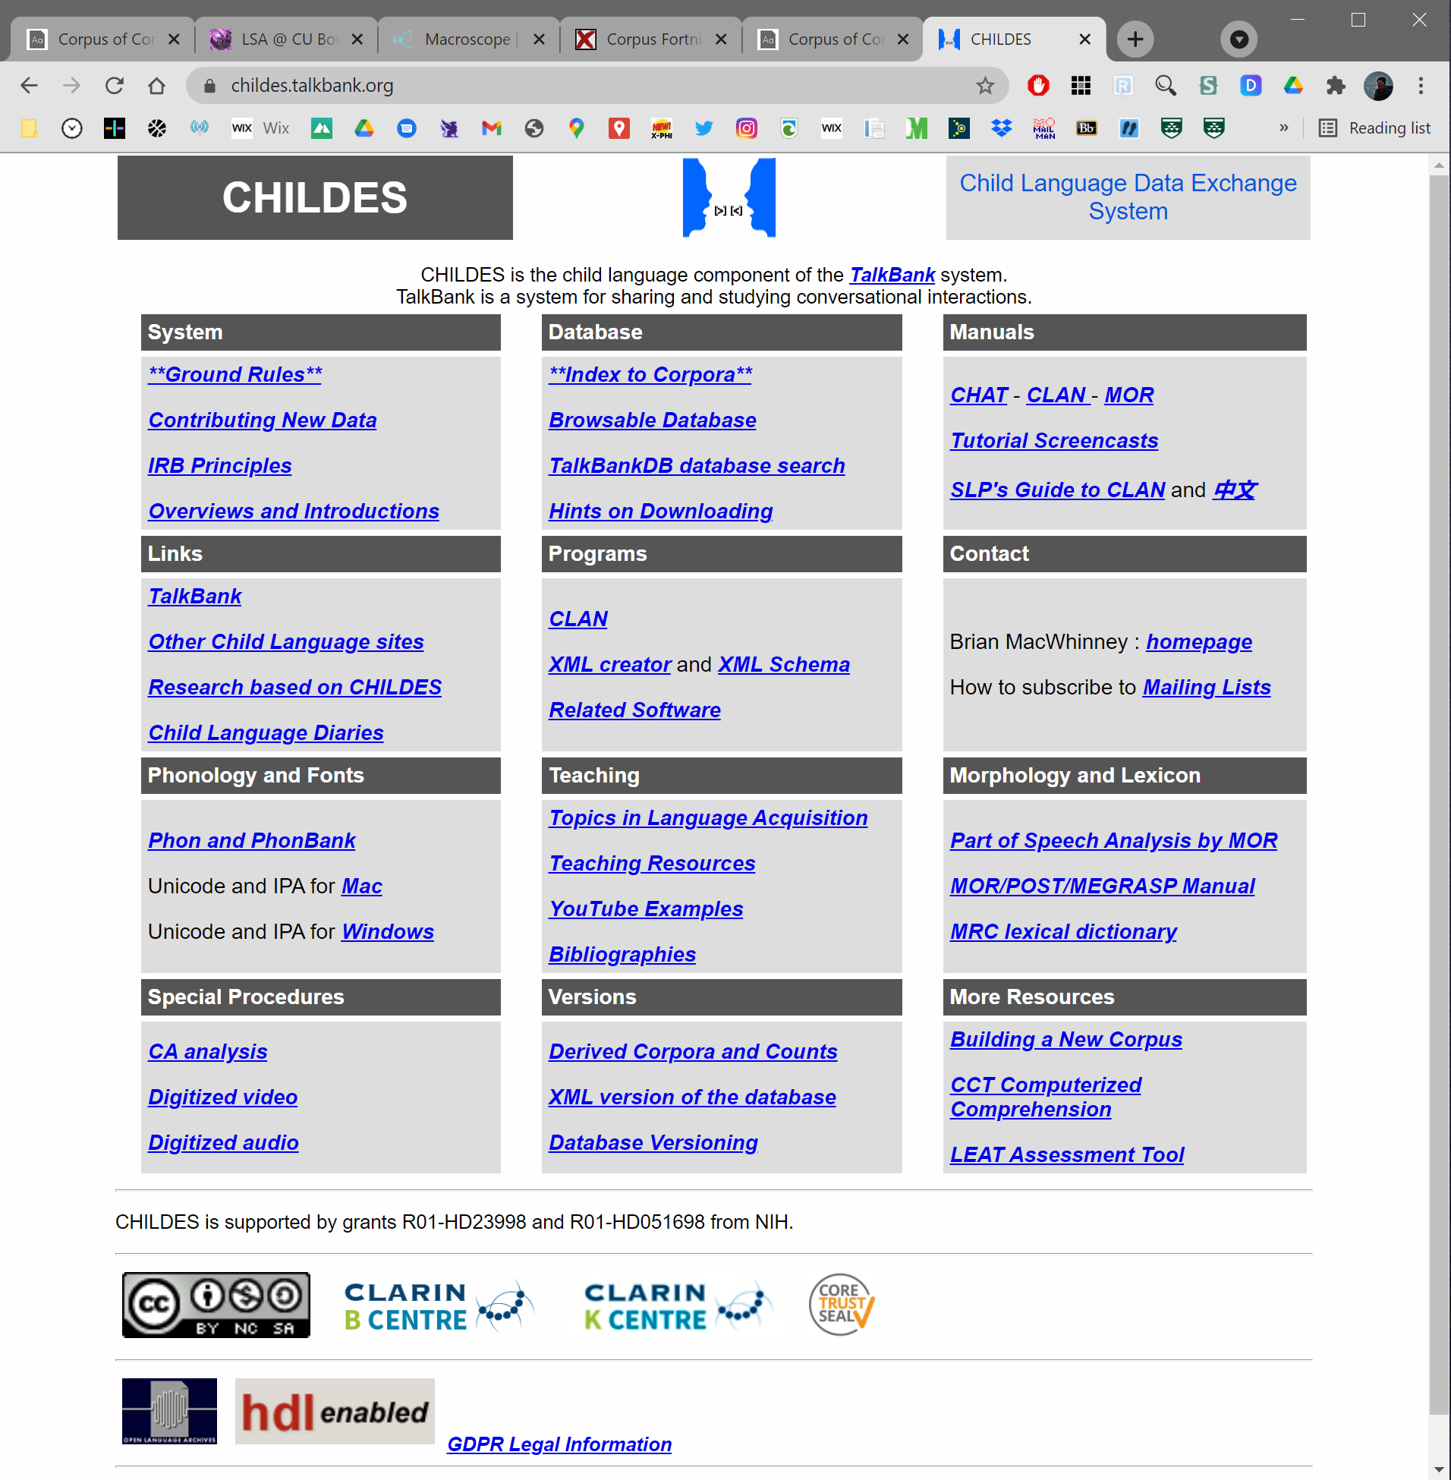
Occurrences of “know” in CHILDES:
corpus of speech involving children
(directed at, made in the presence of).

Slide 53
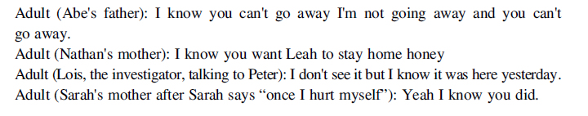
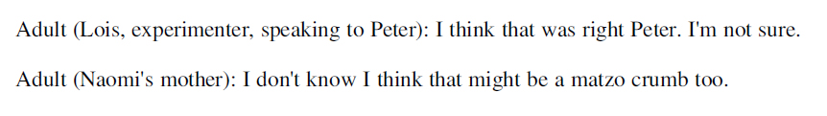
Three independent coders identified 802
instances of positive knowledge attributions:
0 instances where the attribution of knowledge
was accompanied by an expression of
fallibilism about the proposition!
Comparison: 2,290 instances for “think,”
91 accompanied by expression of fallibilism.

Slide 54
One more example
While I’ve defined x-phi broadly, it is
often treated as the empirical study of
philosophical intuitions.
“Experimental philosophy is the name for a recent
movement whose participants use the methods of
experimental psychology to probe the way people make
judgments that bear on debates in philosophy….
All of this work shares a commitment to using controlled
and systematic experiments to explore people’s intuitions
and conceptual usage and to examine how the results
of such experiments bear on traditional philosophical
debates.” (Nadelhoffer & Nahmias 2007, 123)

Slide 55
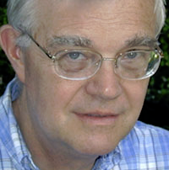
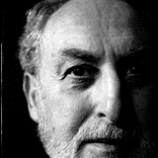
Makes sense given general assumptions that
philosophy is steeped in and methodologically
tied to the use of intuitions as evidence.
In contemporary analytic discussions… “intuition” has become the name for whatever it is that might provide philosophy with a distinctive method and hence preserve it as a separate (in principle) intellectual domain. (Gutting 1998, 7)
One thing that distinguishes philosophical methodology from the methodology of the sciences is its extensive and avowed reliance on intuition. (Goldman 2007, 1)

Slide 56
Interestingly, Goldman takes intuition
talk to be a recent development.
As a historical matter, philosophers haven’t always described their methodology in the language of intuitions. In fact, this seems
to be a fairly recent bit of usage. (2)
New language or new method?
And is this historical claim even true?
If so, what explains the change?

Slide 57
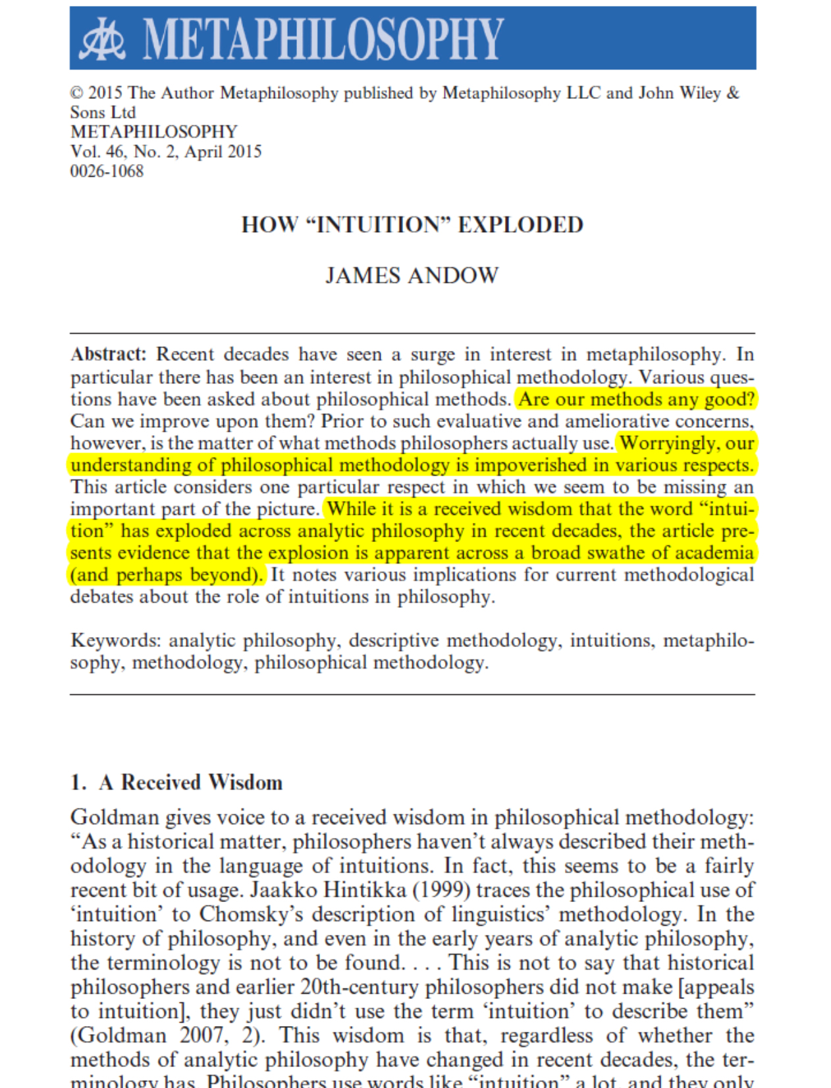
Explored more systematically by James
Andow using corpus methods.

Slide 58
Tallant (2013): Use of “intuition” / “intuitive” /
“intuitively” / “counter-intuitive” / “counter-
intuitively” in five physics journals steadily
increased from 7.44% of articles in 2001 to
9.25% of articles in 2011.
Andow: 1.95% in the 1960s to 7.89% in 2000s.
Google’s NGram corpus:
4x increase from 1800 to 2000.

Slide 59
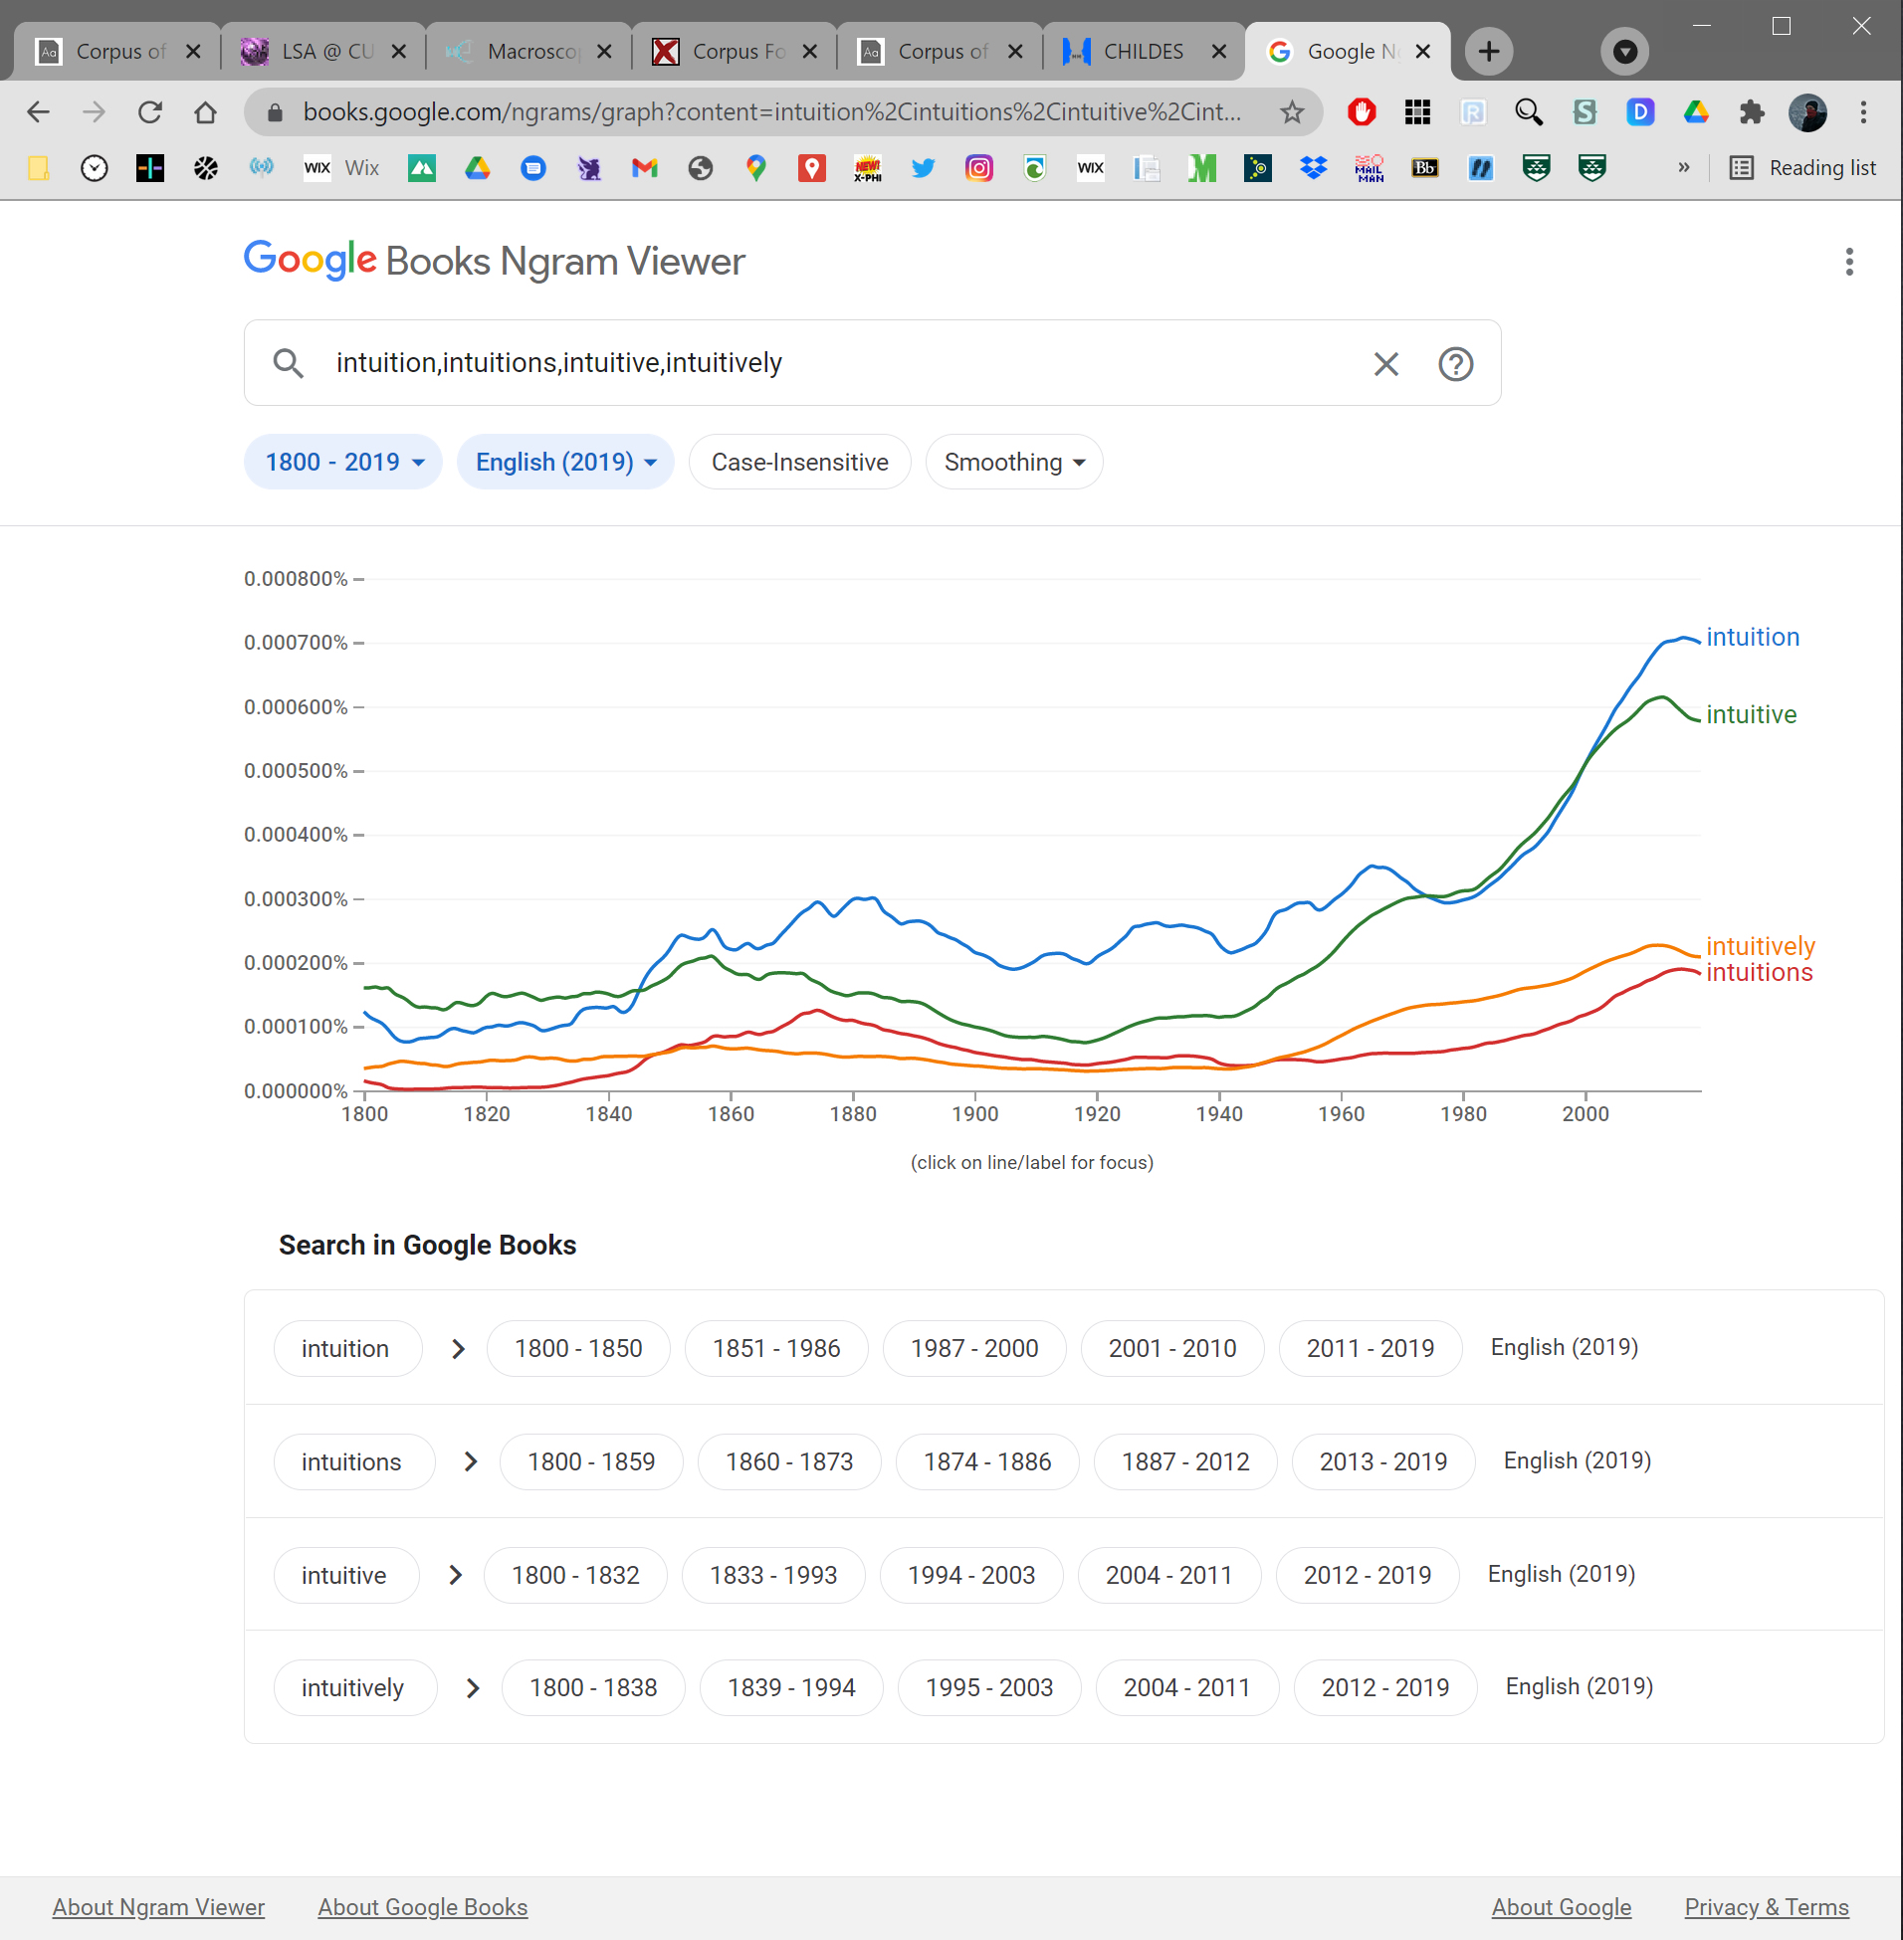

Slide 60


Slide 61

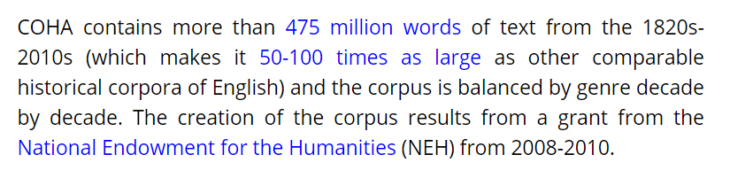
?

Slide 62
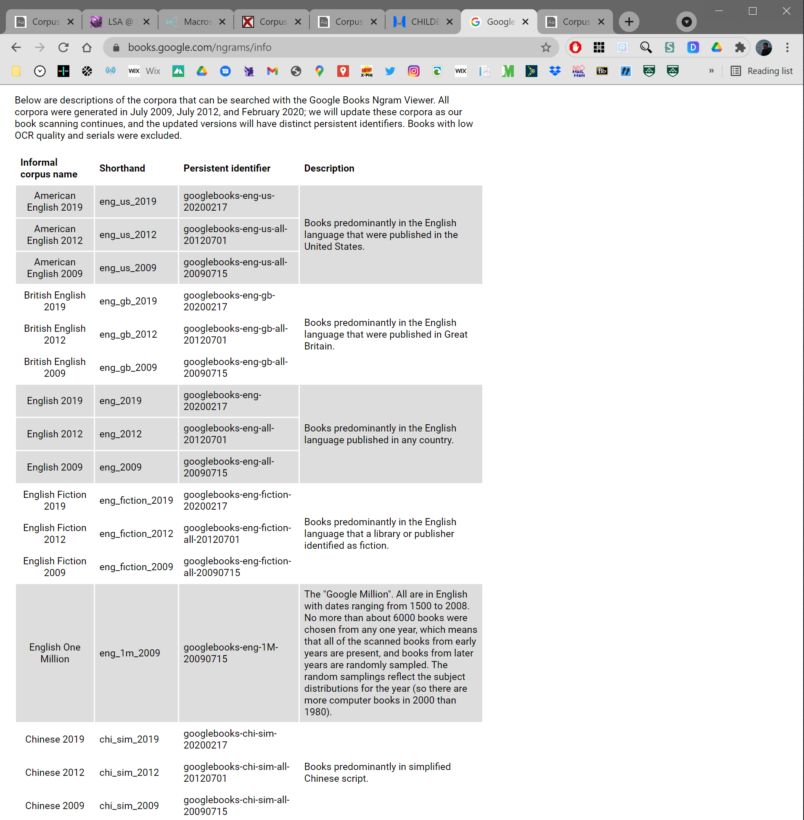
?

Slide 63
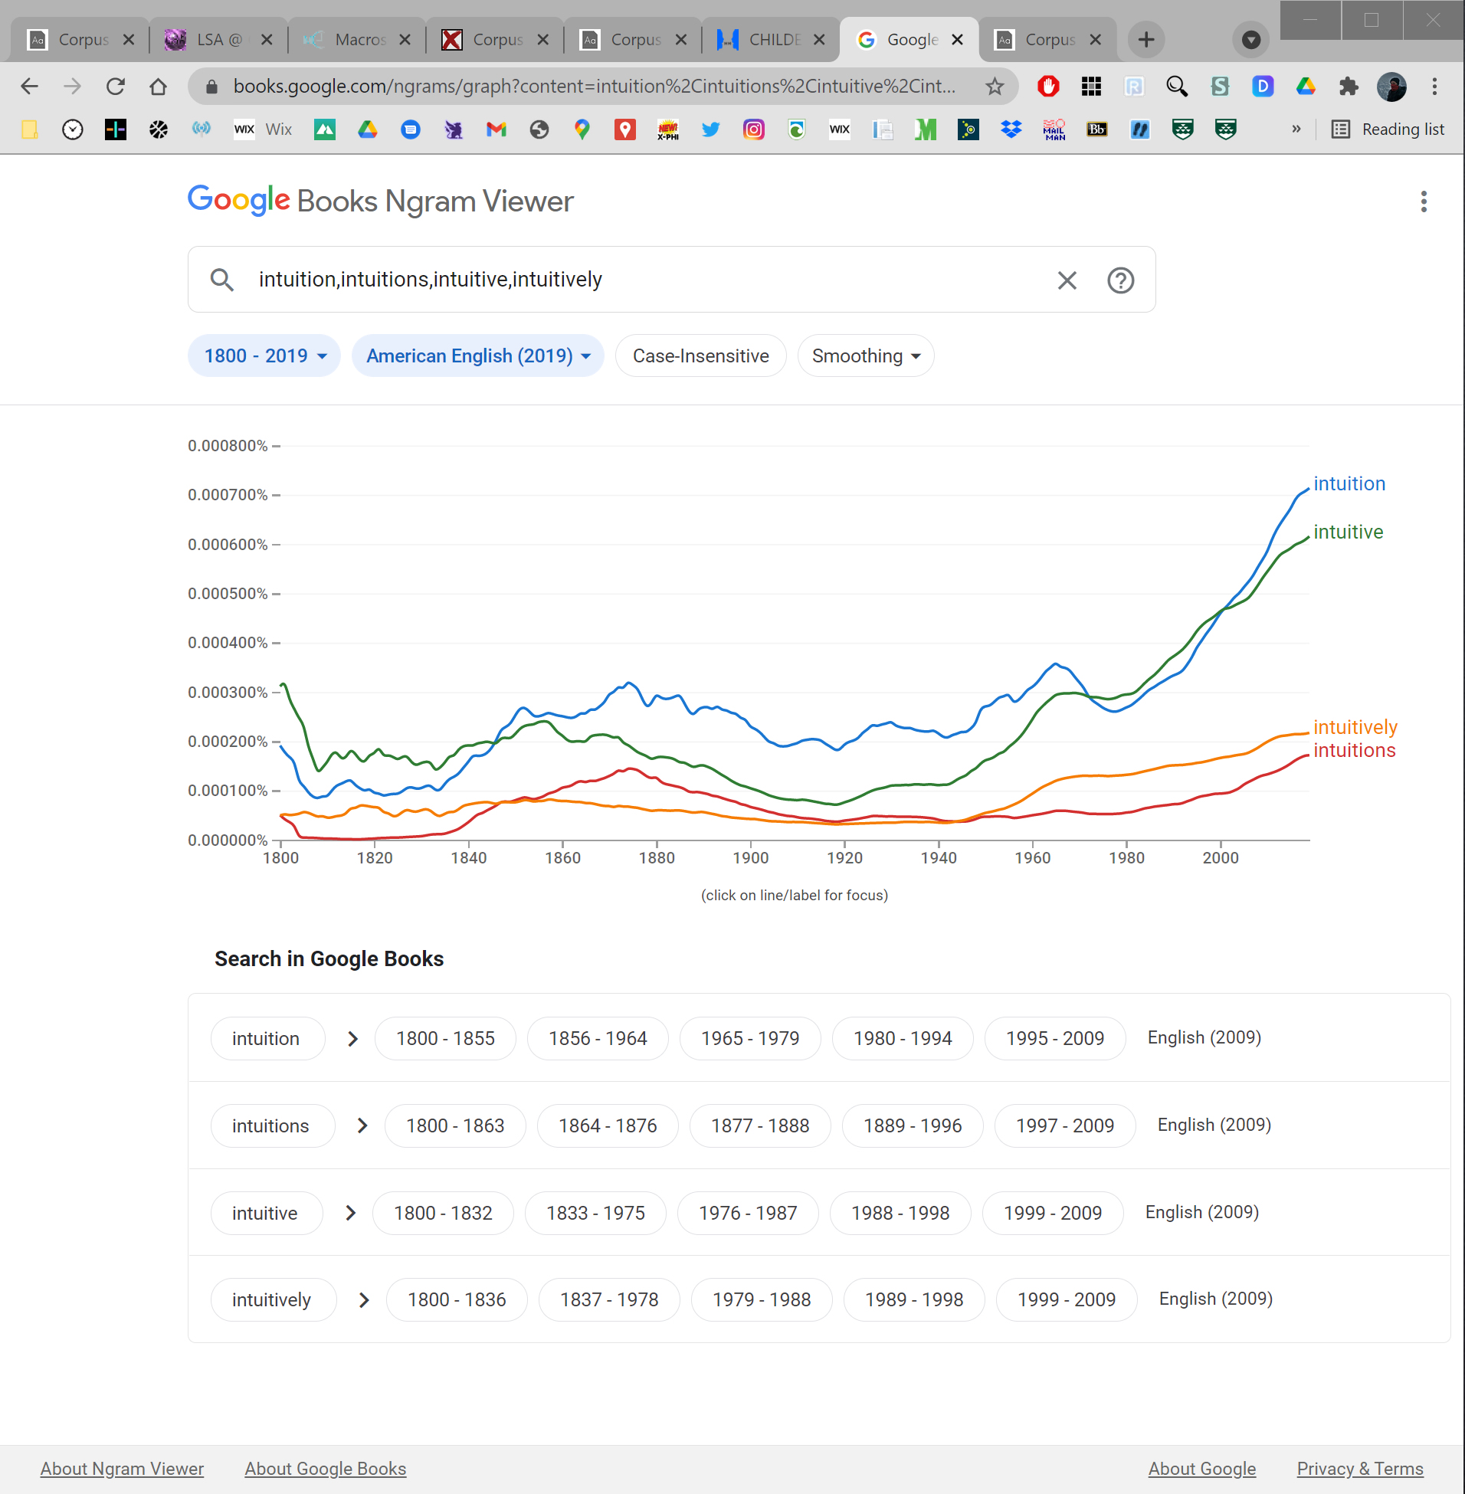

Slide 64





Slide 65
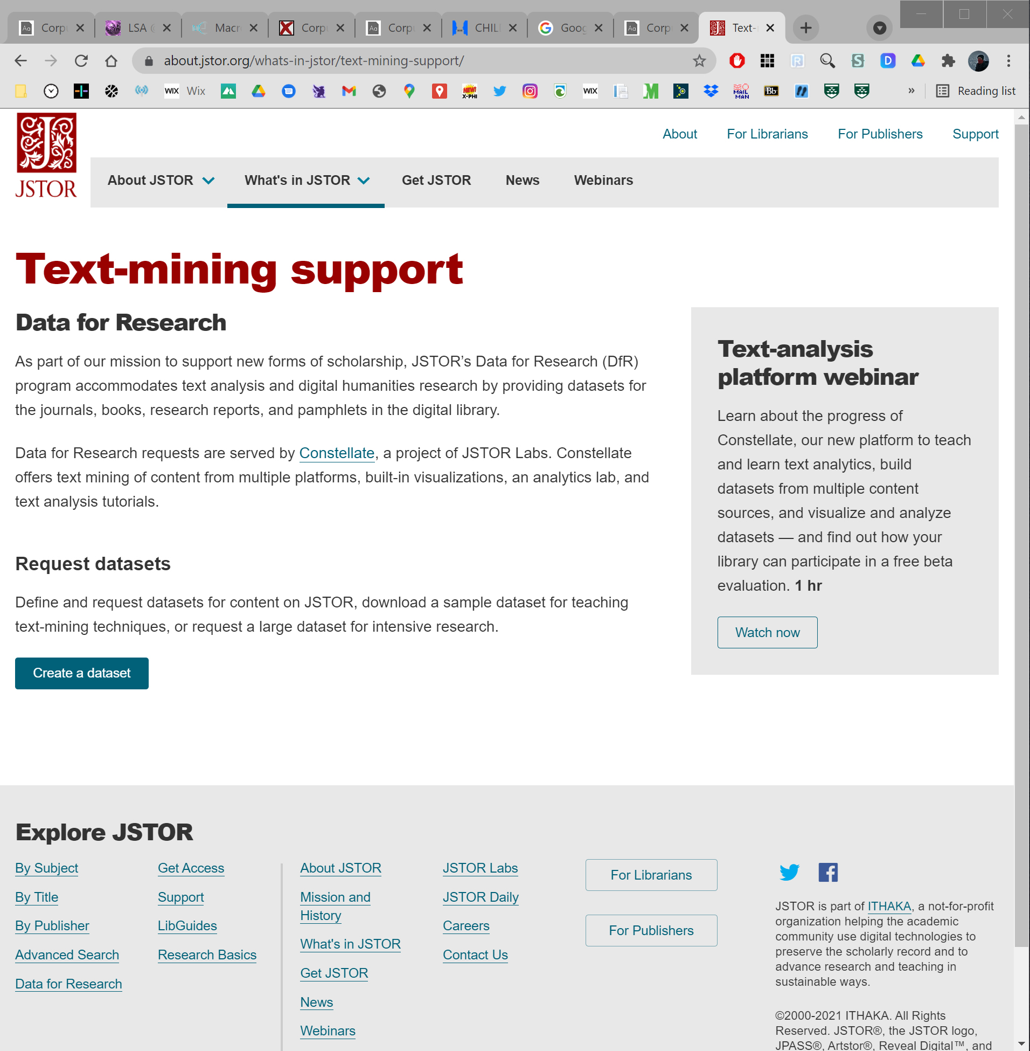
Main Study
“intuition” / “intuitions” / “intuit” / “intuitive” /
“counter-intuitive” / “intuitively” / “counter-
intuitively” in journal research articles in
English in JSTOR

Slide 66
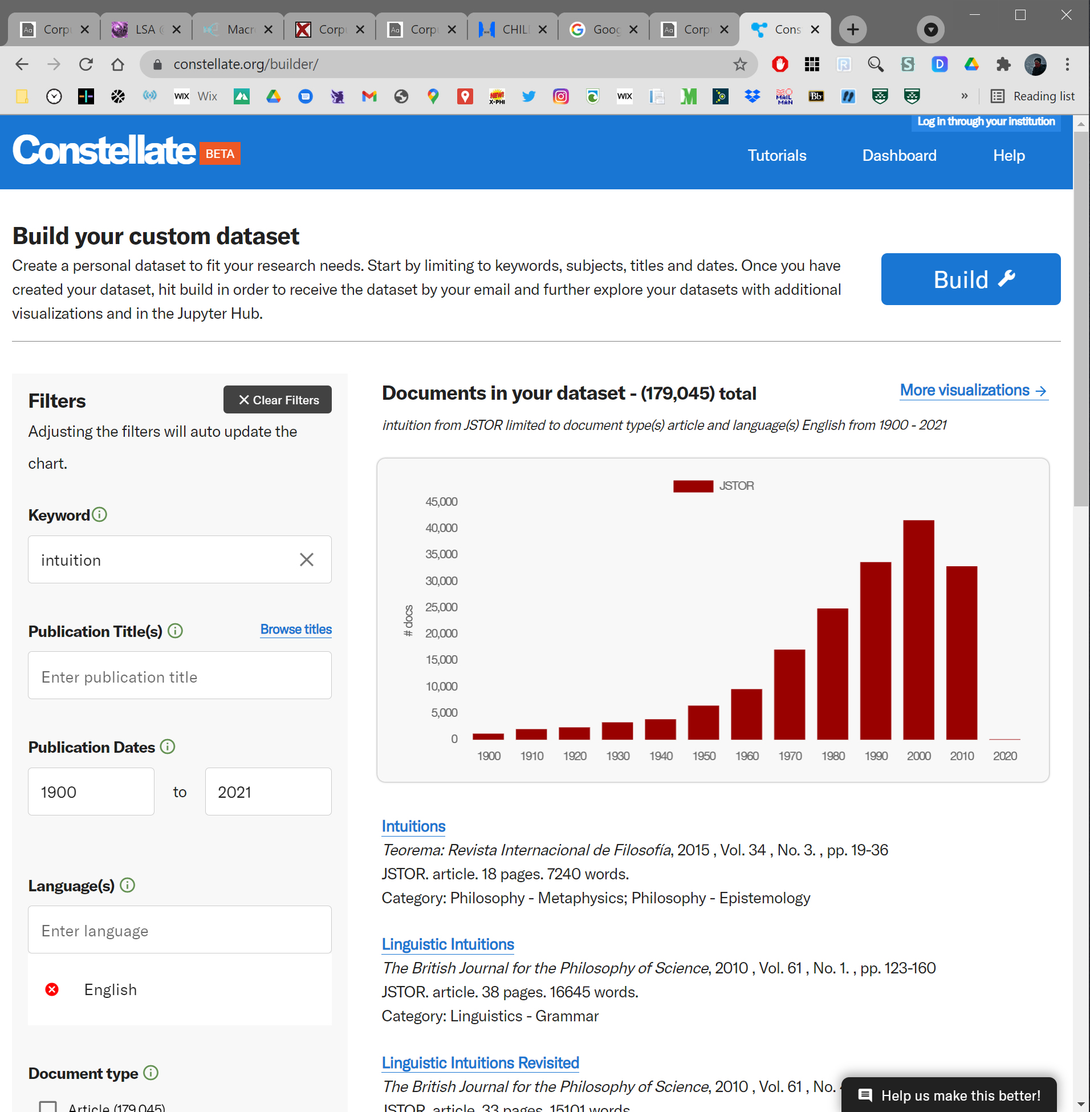

Slide 67
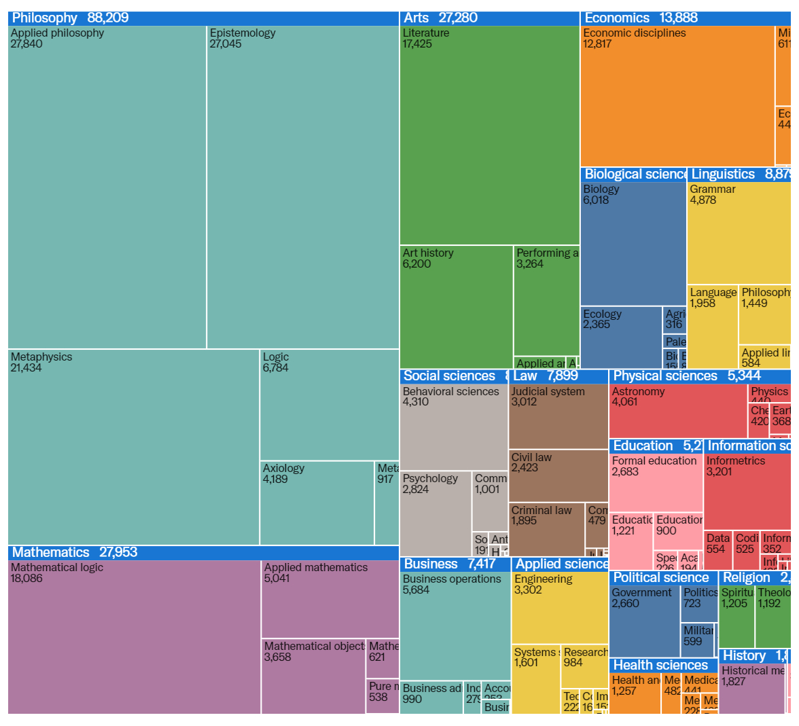

Slide 68

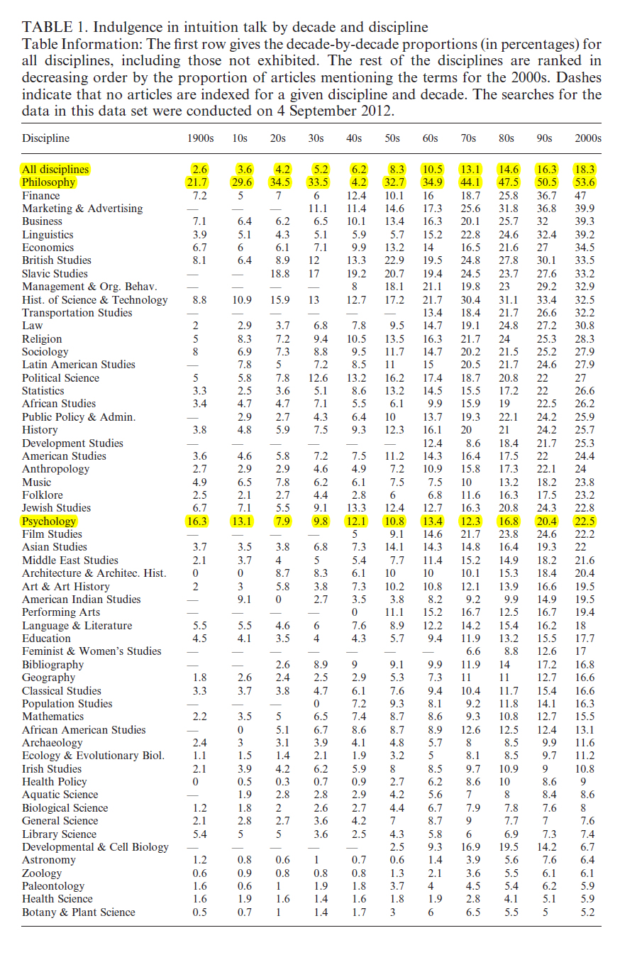
The headline finding is that… an increase in the proportion of articles using at least one of these terms was apparent across the broad swath of academia indexed (196)

Slide 69
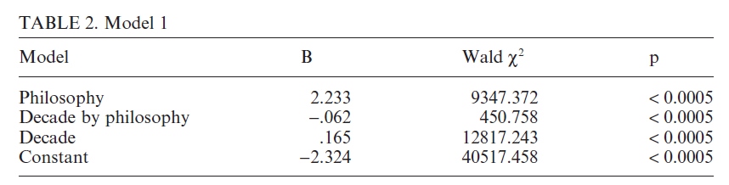
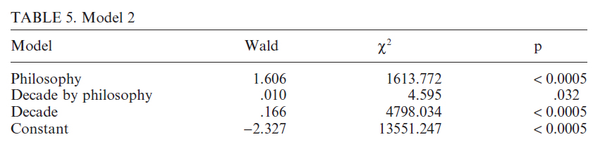
(after 1950)

Slide 70
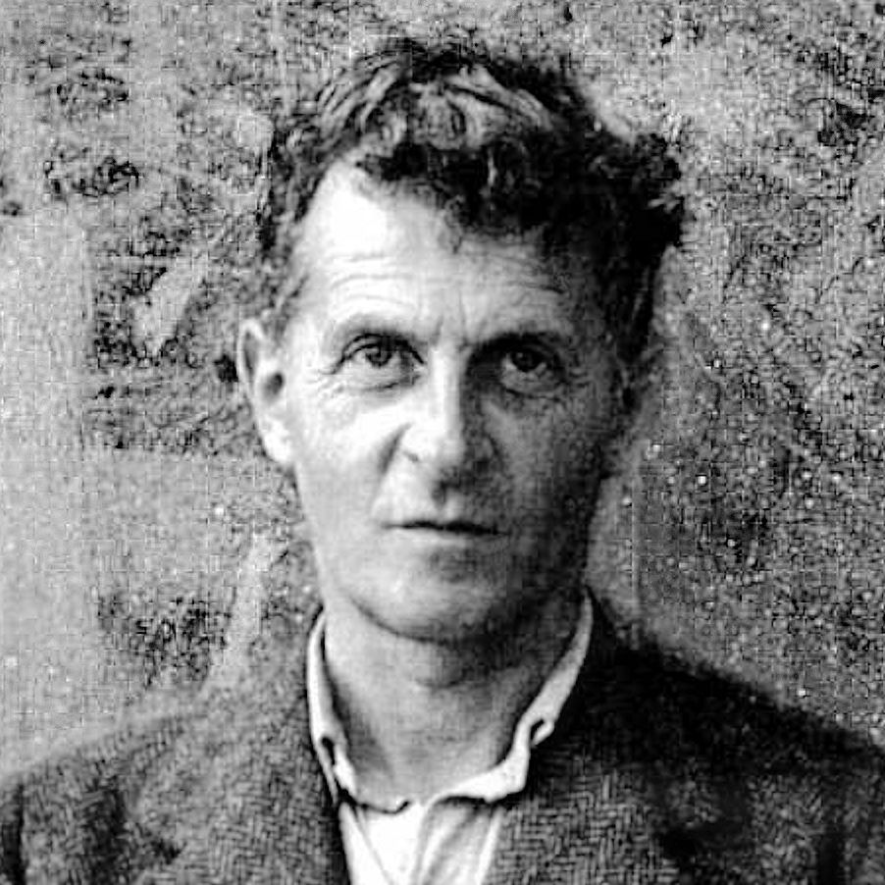
in the early years of analytic philosophy, the terminology is not to be found
it doesn’t seem to be true
Don’t think, but look! (PI 66)

